Slide 1


Curve Your Enthusiasm:
Advancements in Systems of Estimation
with
Paul M. Garrett
Welcome

Slide 2
Overview
Estimation and Estimation Systems
Systems Factorial Technology (SFT)
Applying SFT to Estimation Systems (Studies 1 & 2)
Future Work: A-priori estimates of Trial N and Stochastic Dominance using the LBA
Introduction

Slide 3
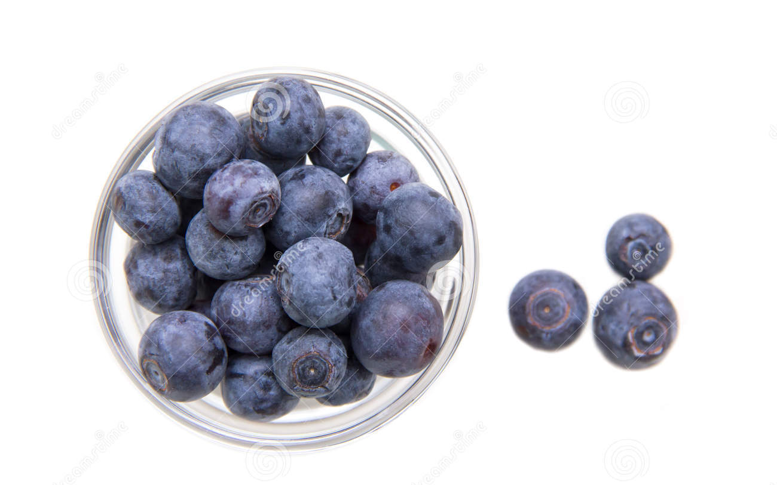
Systems of Estimation
Estimation – fast, parallel approximation of a large quantity
Estimation System – describes how we combine or compare two large quantities
System Architecture: Parallel vs Serial
System Workload: Limited vs Unlimited
System Stopping Rule: Min vs Max Time
Introduction

Slide 4
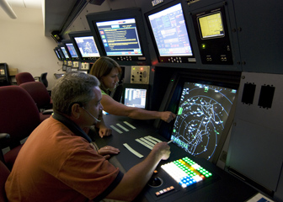
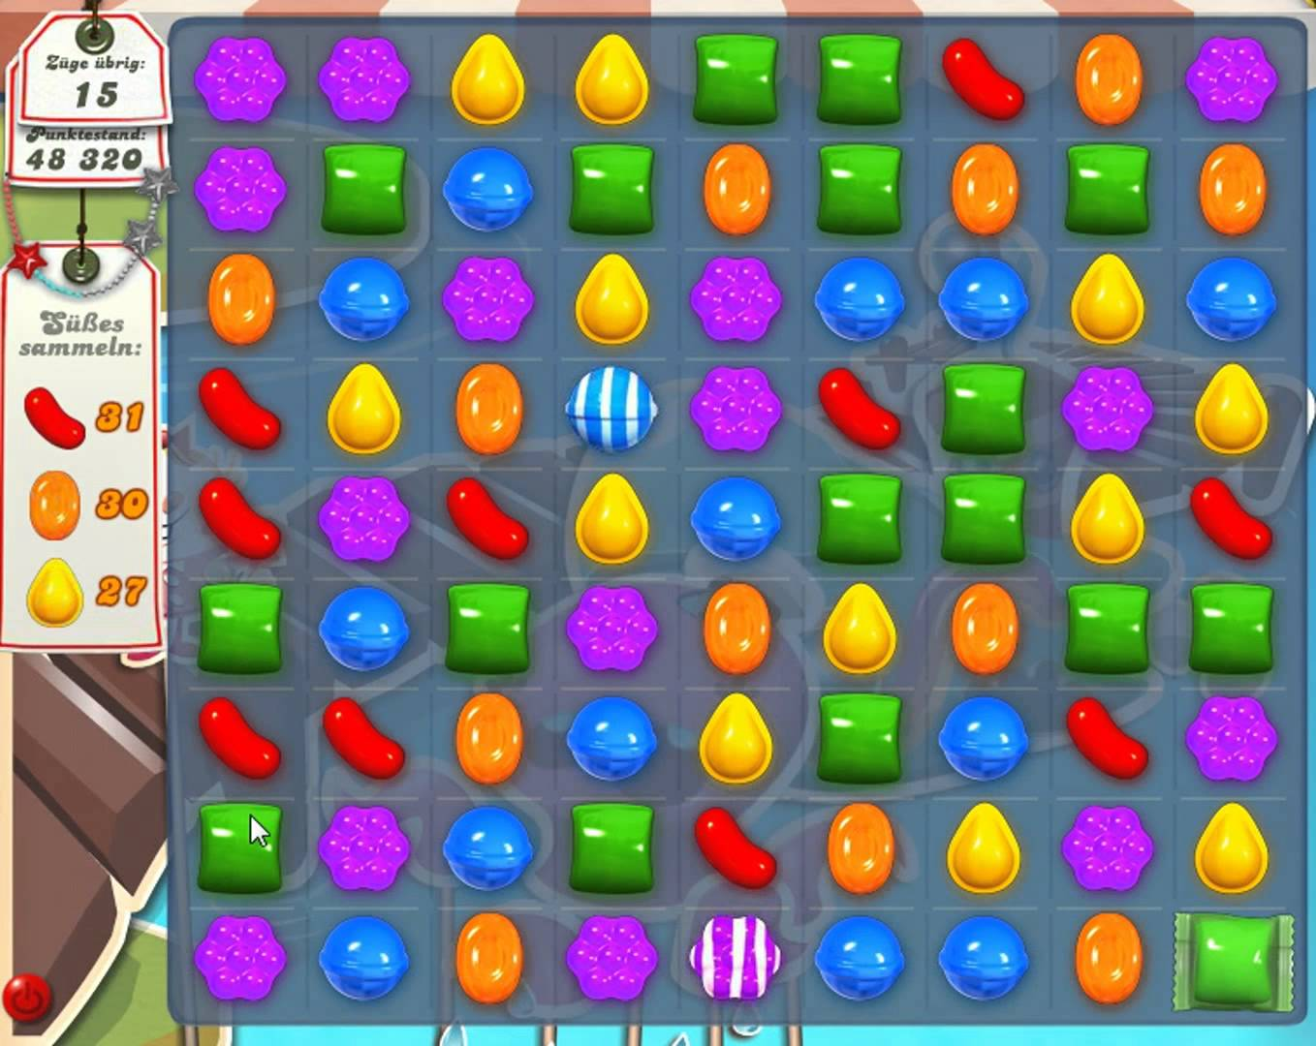
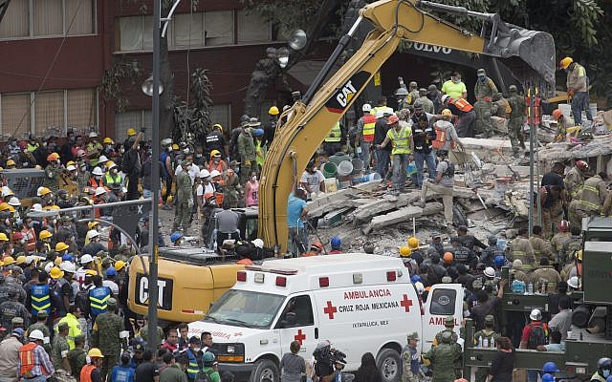
Why are Estimation Systems Important?
Air Traffic Controllers
Emergency Rescue Personnel
Crowds finding the fastest exit
Educators – links to mathematical ability and IQ
Anyone who has played candy crush
Importance

Slide 5
Estimation System – Architecture
Parallel Estimation System
Serial Estimation System
Estimation Systems

Slide 6
Estimation System – Architecture
Parallel Estimation System
Serial Estimation System
Estimation Systems

Slide 7
Estimation System – Workload Capacity
Limited Parallel Estimation System
Unlimited Serial Estimation System
Estimation Systems

Slide 8
Estimation System – Stopping Rule
Serial Min Time (Self-Terminating)
Serial Max Time (Exhaustive)
Estimation Systems
Target Query. Either Set Contains Five or More Items
Target Query. Both Sets Contain Five or More Items

Slide 9
Primary Research Questions
What is the primary architecture of our Estimation System? Parallel or Serial
Under what System Capacity do Estimation Systems Operate? Limited, Unlimited or Super
Aim

Slide 10
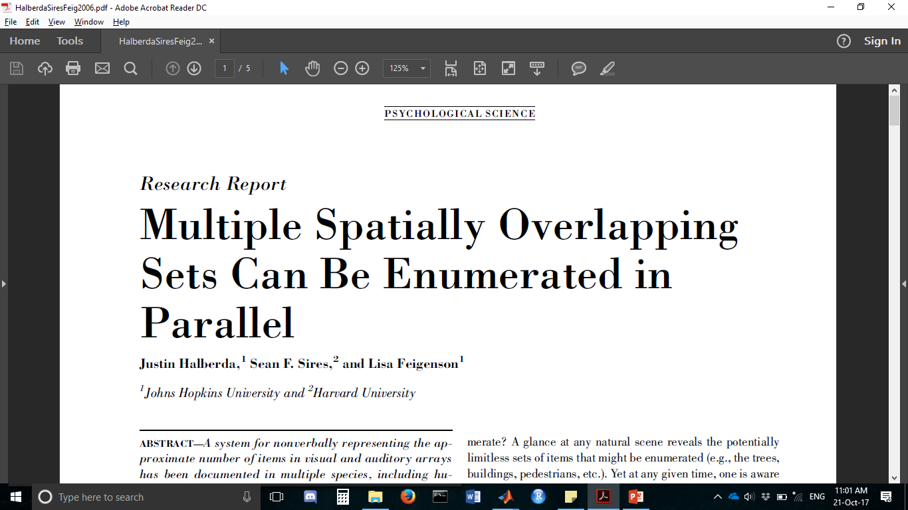
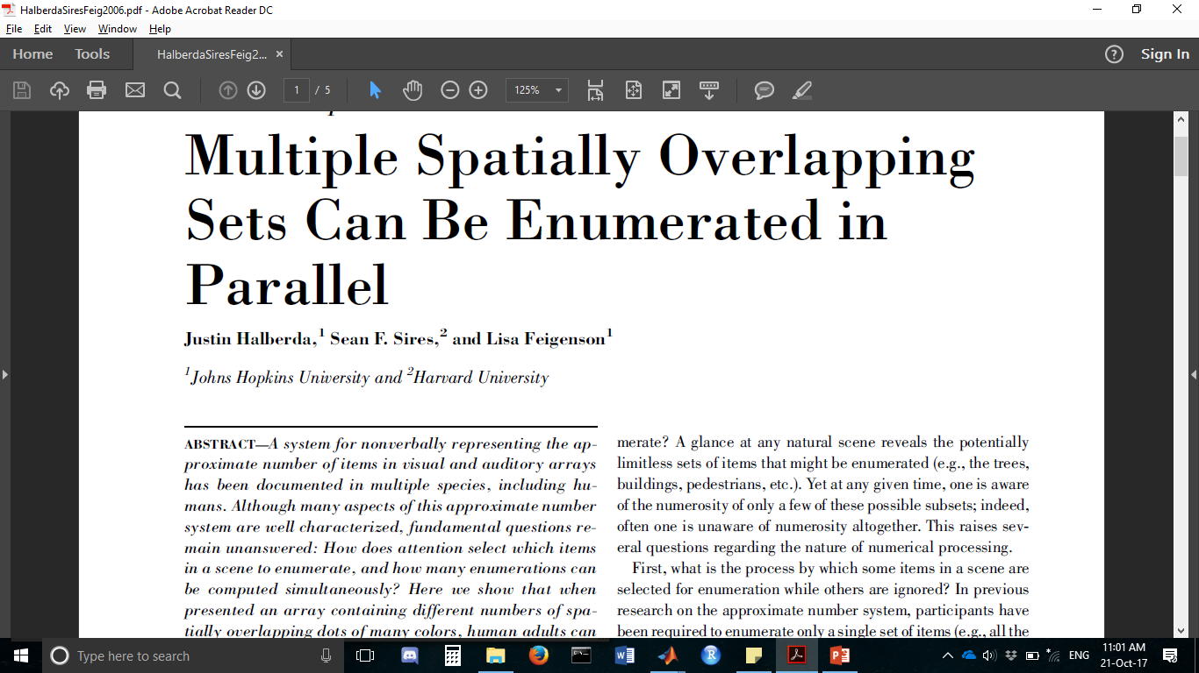
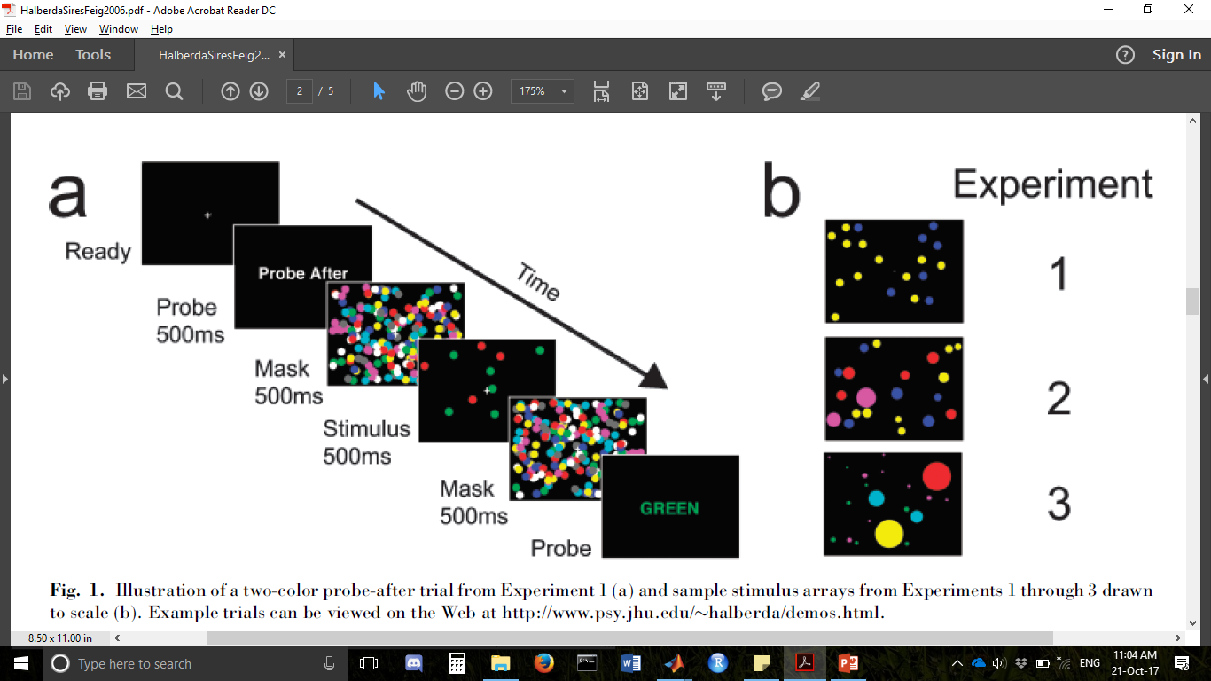
Experiment
Previous Research
1. Size
2. Area
3. Contour Length

Slide 11
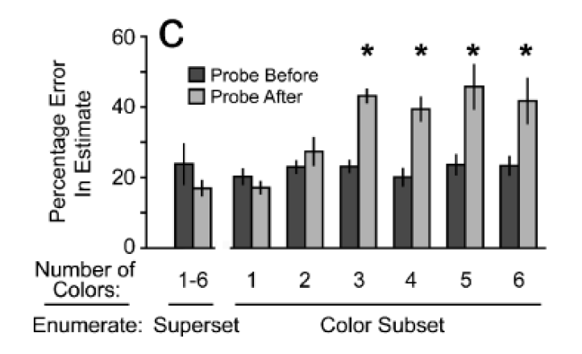
“…percentage error on probe-after trails increased abruptly when the stimulus included three or more color subsets. We took this categorical increase… to indicate the number of sets each participant could enumerate in parallel.”
Previous Research

Slide 12
Issues with Interpretation
Mean RT non-diagnostic measure of Architecture (model mimicry)
Analysis incapable of directly indexing capacity
Minor: Accuracy of exact (typed) response was based on SD to the mean.
Previous Research

Slide 13
Systems Factorial Technology
Target Item – Dot of Light
Manipulation of Load
Redundant Target Task
Manipulation of Salience
Brightness/Contrast of Dots
Target A
Present
Absent
High Low
HH
LH
SFT
Present
Low High
Target B
HL
LL
Absent

Slide 14
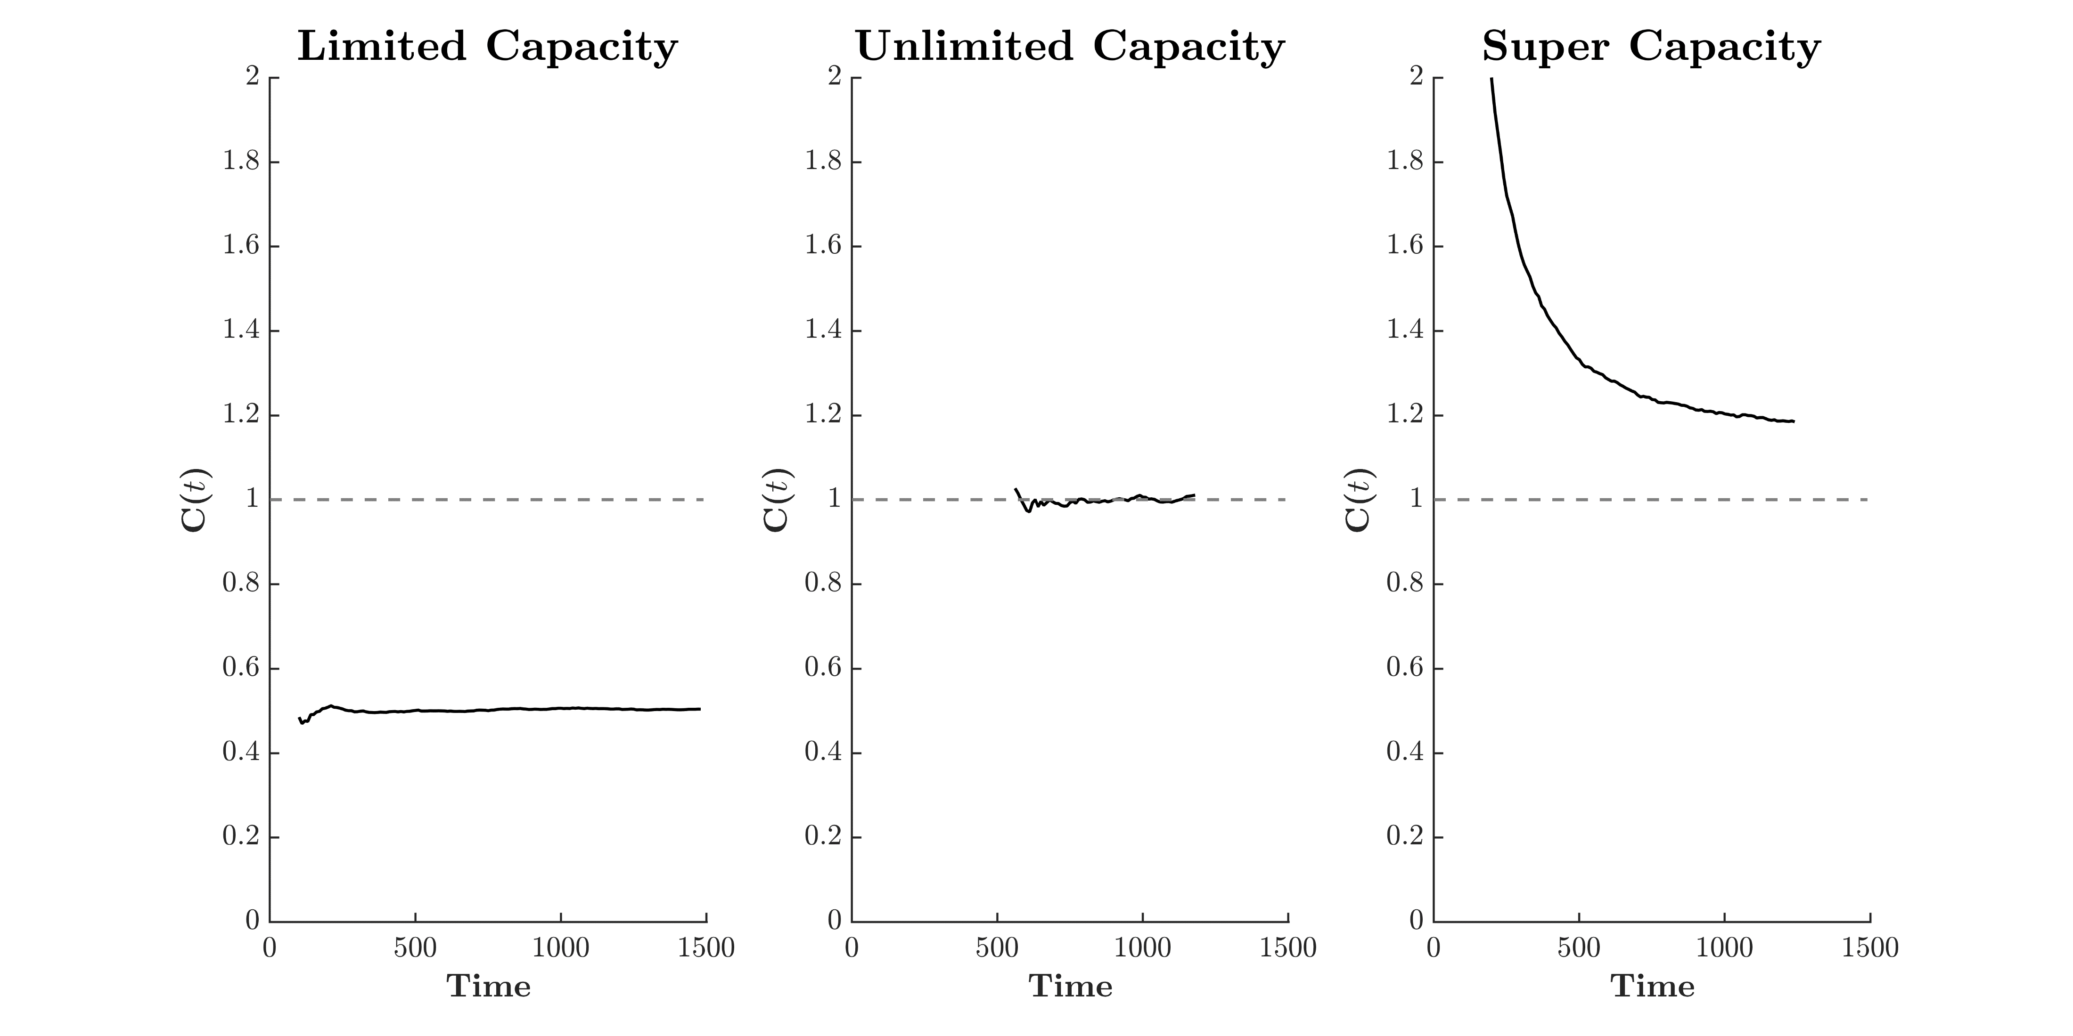
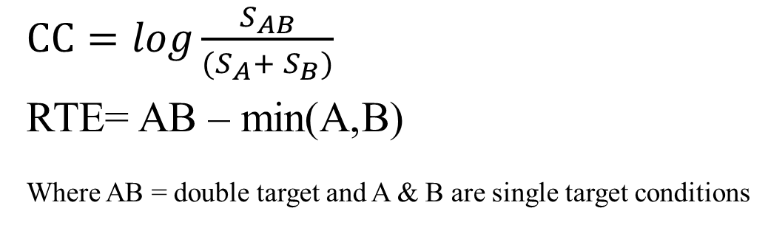
Systems Factorial Technology
Target A
Present
Absent
High Low
HH
LH
SFT
Present
Low High
Target B
HL
LL
$CC=log\frac{S_{AB}}{(S_{A}+ S_{B})}$
RTE= AB – min(A,B)
Where AB = double target and A & B are single target conditions
Absent

Slide 15
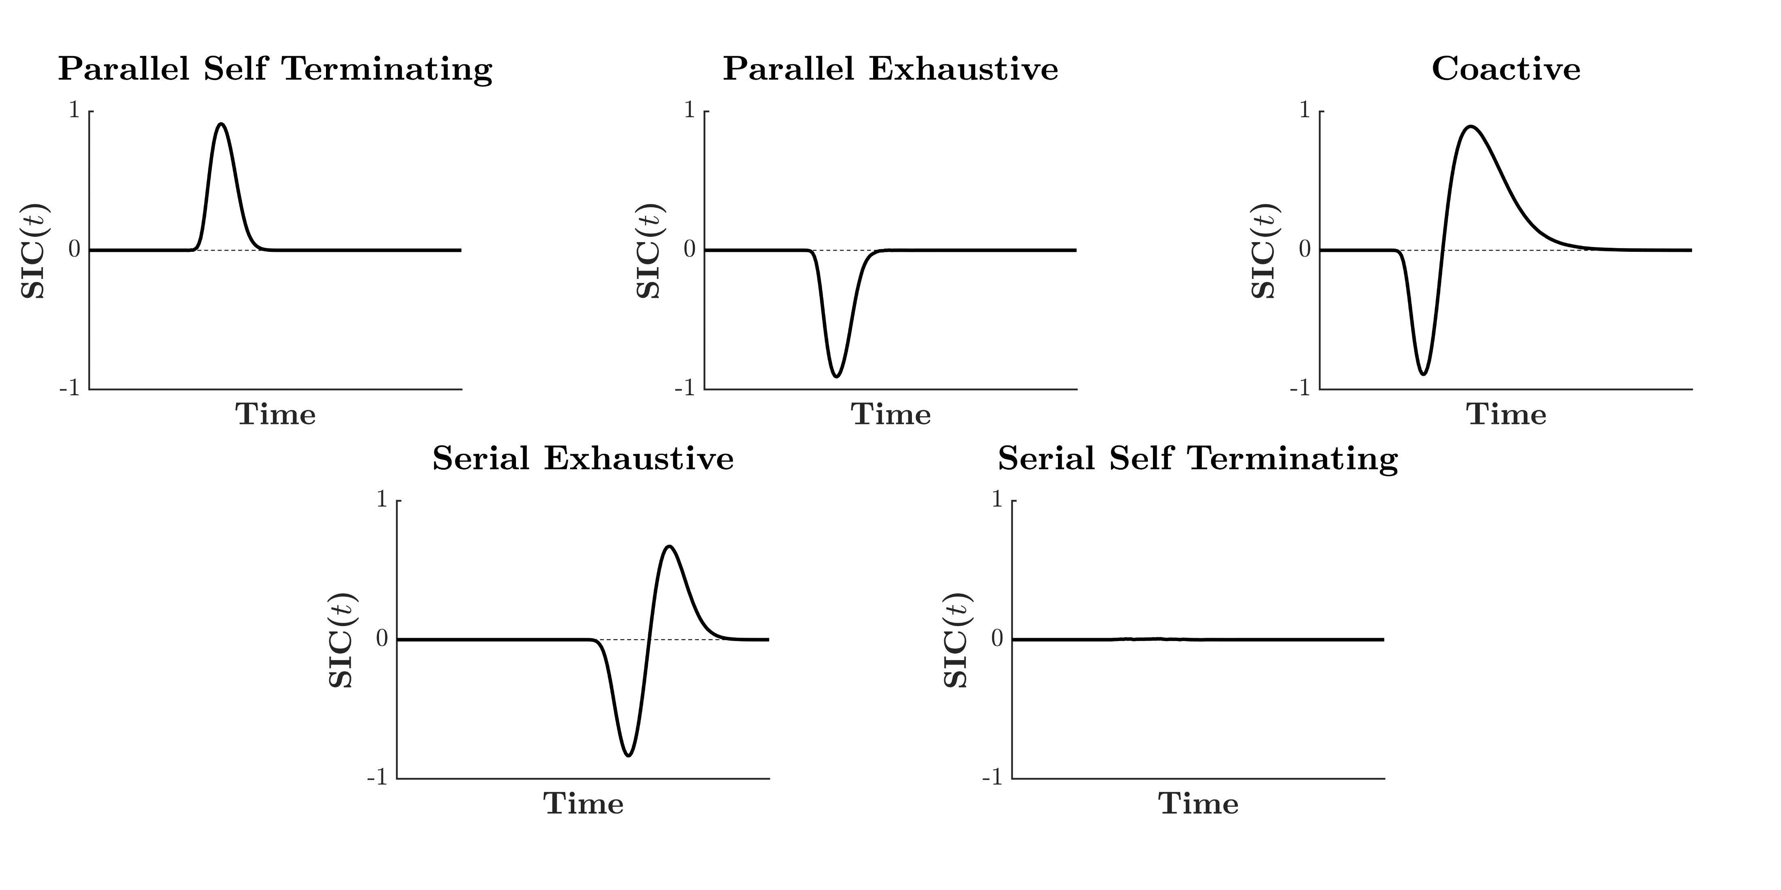
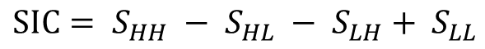
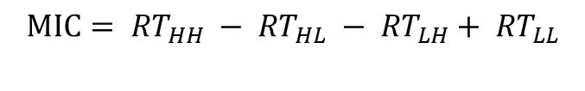
Systems Factorial Technology
Target A
Present
Absent
High Low
HH
LH
SFT
Present
Low High
Target B
HL
LL
$$SIC= S_{HH} − S_{HL} − S_{LH}+ S_{LL}$$
$$MIC= {RT}_{HH} − {RT}_{HL} − {RT}_{LH}+ {RT}_{LL}$$
Absent
Parallel Min Time | MIC > 0
Parallel Max Time | MIC < 0
Serial | MIC == 0

Slide 16
Applying SFT to Estimation
Binary Response Sets
Present Two Item Sets
Is either set less than 20?
Measuring Capacity
Redundant Target Task
Target Red
Present
Absent
Salience Red
Salience Red
< 20
< 20
> 20
< 20
Present
SFT Estimation
Salience Blue
Salience Blue
Target Blue
Salience Red
Salience Red
< 20
> 20
> 20
< 20
Absent
Salience Blue
Salience Blue

Slide 17
Applying SFT to Estimation
Binary Response Sets
Present Two Item Sets
Is either set less than 20?
Measuring Architecture
Salience Manipulations?
Numerical Distance Effect
“Item sets closer in size are harder to compare.”
Target Red
Present
Absent
Salience Red
Salience Red
High
Low
High
Low
High
?
?
?
?
High
?
?
?
?
Present
SFT Estimation
Salience Blue
Salience Blue
?
?
?
?
?
?
?
?
Low
Low
Target Blue
Salience Red
Salience Red
High
Low
High
Low
High
?
?
?
?
?
?
?
?
High
Absent
Salience Blue
Salience Blue
?
?
?
?
?
?
?
?
Low
Low

Slide 18
Study 1
Aim Assess the Numerical Distance Effect and choose values for SFT Salience Effects
Single Item Set Presentations
Criterion Task: Is the set less than 20?
Methodology

Slide 19
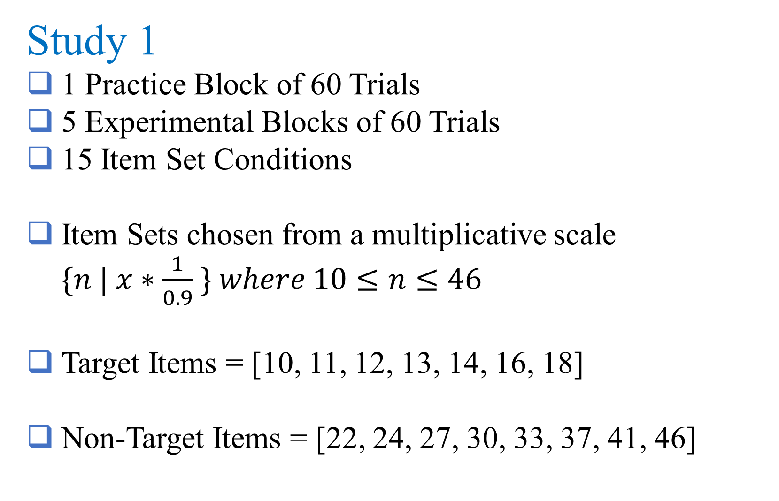
Study 1
1 Practice Block of 60 Trials
5 Experimental Blocks of 60 Trials
15 Item Set Conditions
Item Sets chosen from a multiplicative scale $\{n | x∗\frac{1}{0.9} \} where 10≤n≤46$
Target Items = [10, 11, 12, 13, 14, 16, 18]
Non-Target Items = [22, 24, 27, 30, 33, 37, 41, 46]
Methodology

Slide 20
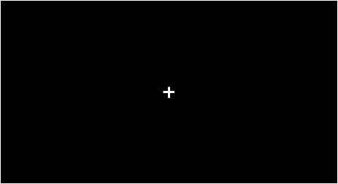


Study 1
Methodology
Is the set less than 20?

Slide 21
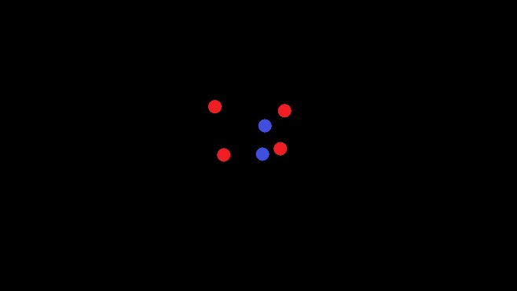
Study 1
ITI
500ms
Fixation Cross
500ms
RTI
4000ms
Study 1
Stimulus
1000ms
Mask
500ms
Post Mask Blank
2500ms

Slide 22
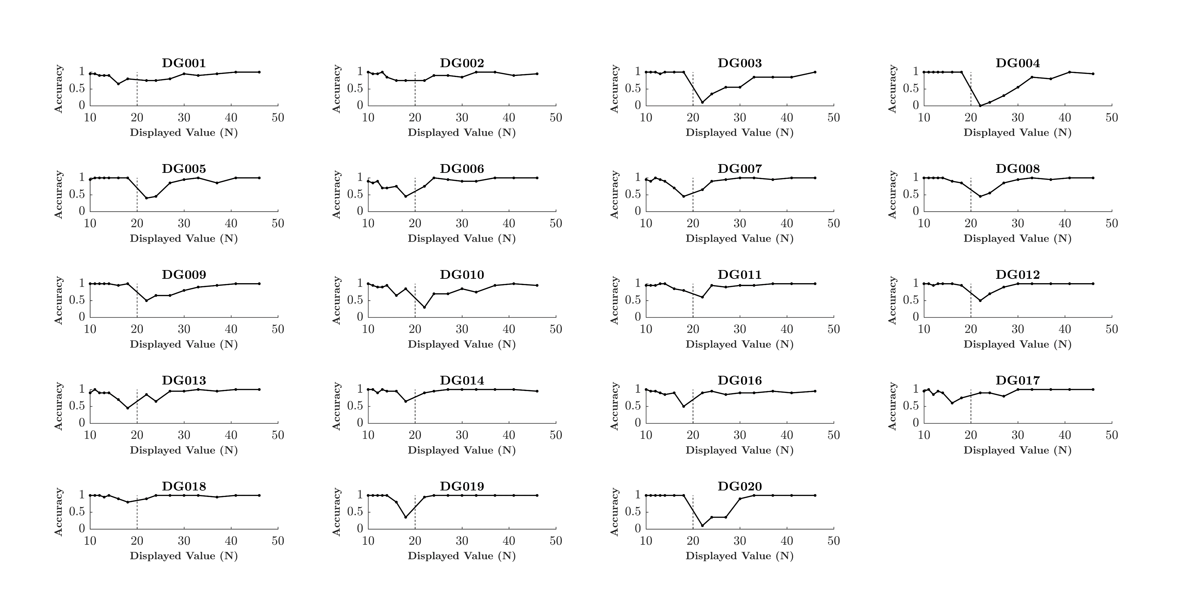
Study 1
Study 1

Slide 23
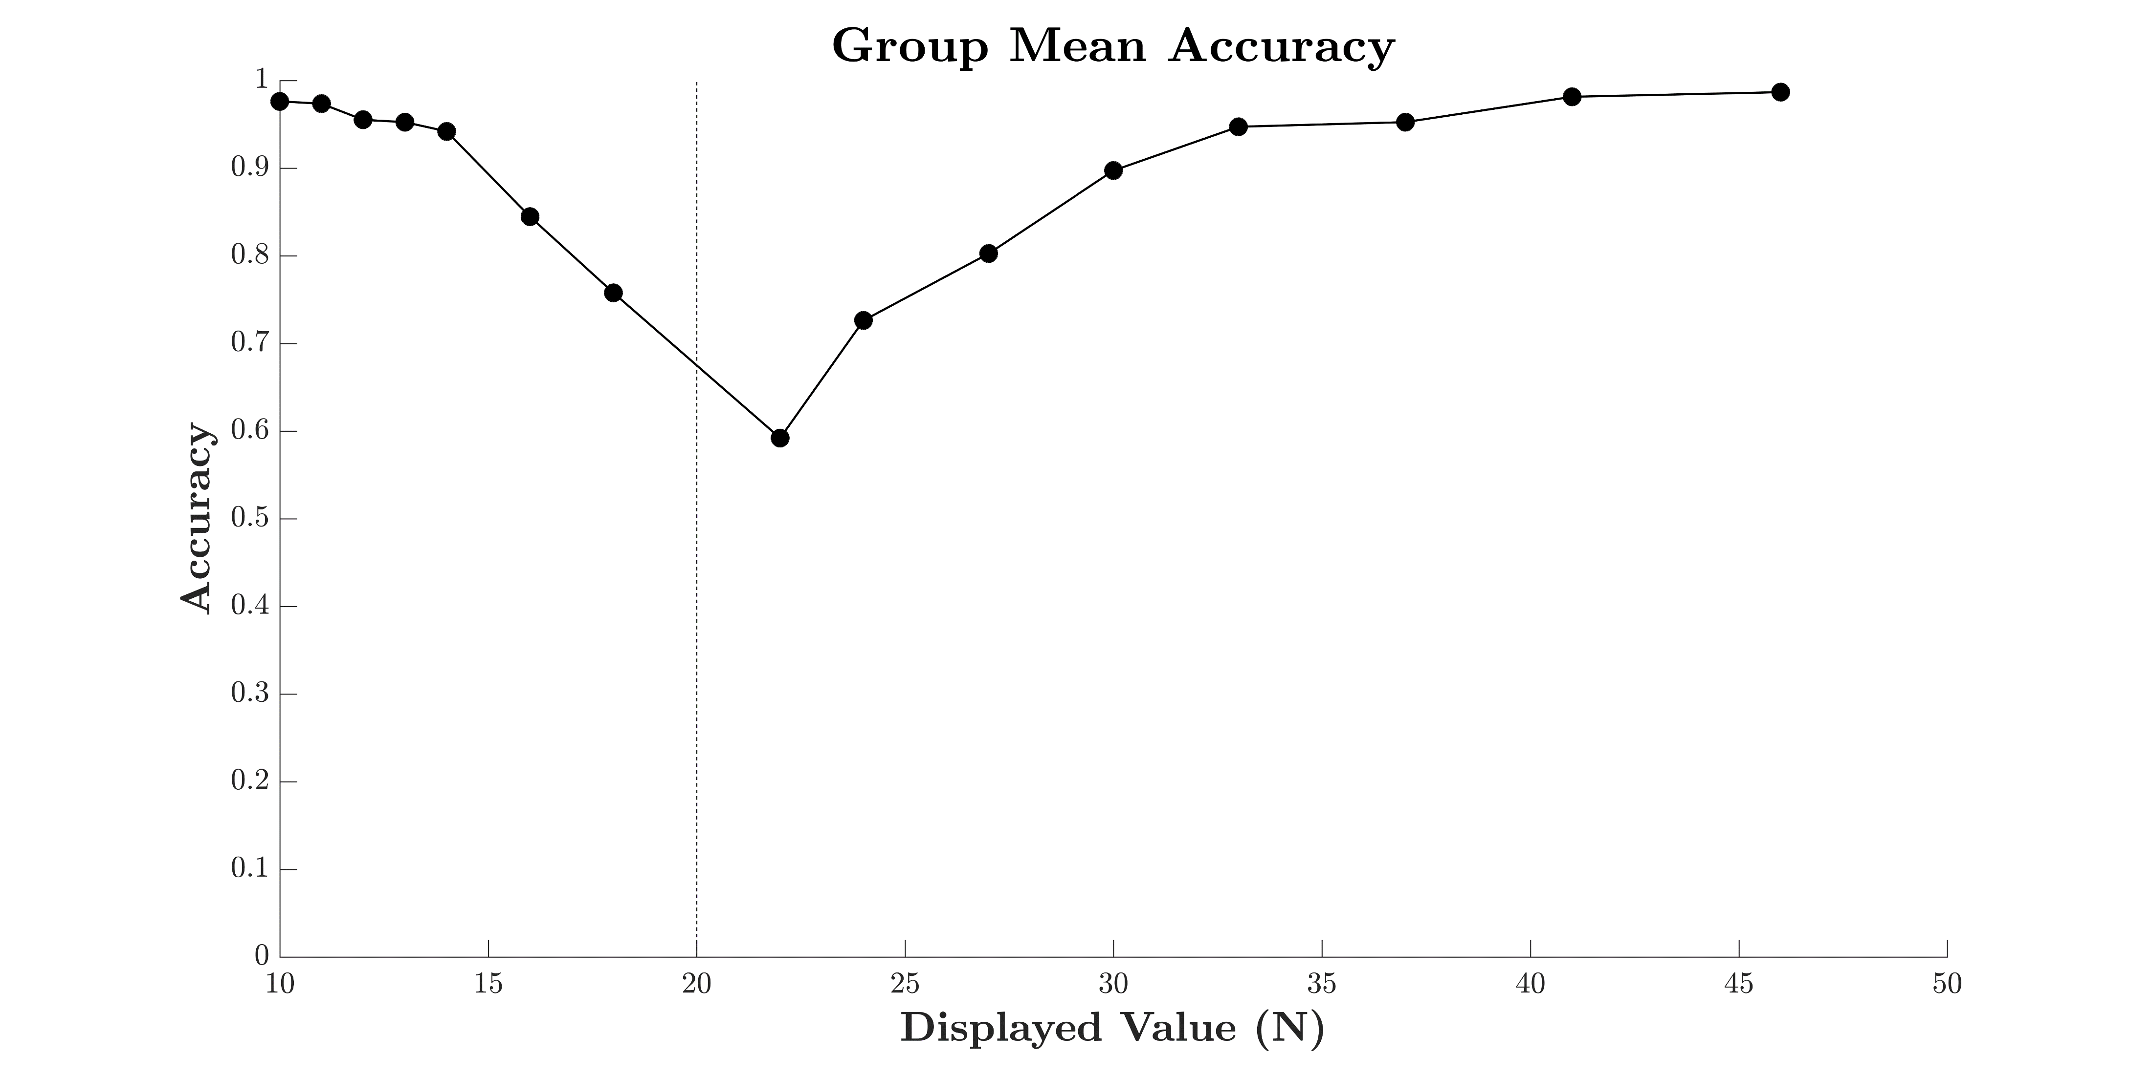
Study 1
Study 1

Slide 24
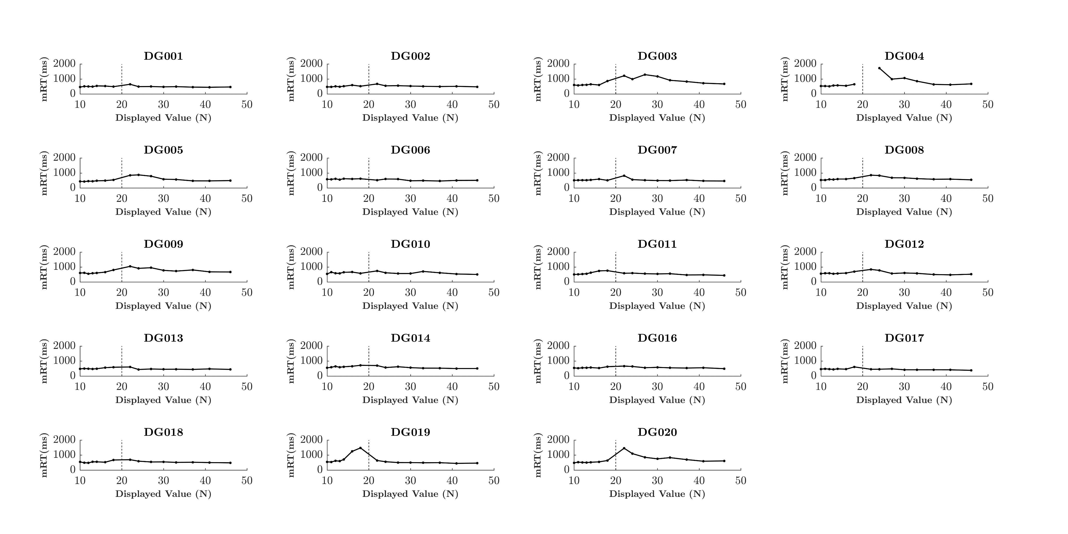
Study 1
Study 1

Slide 25
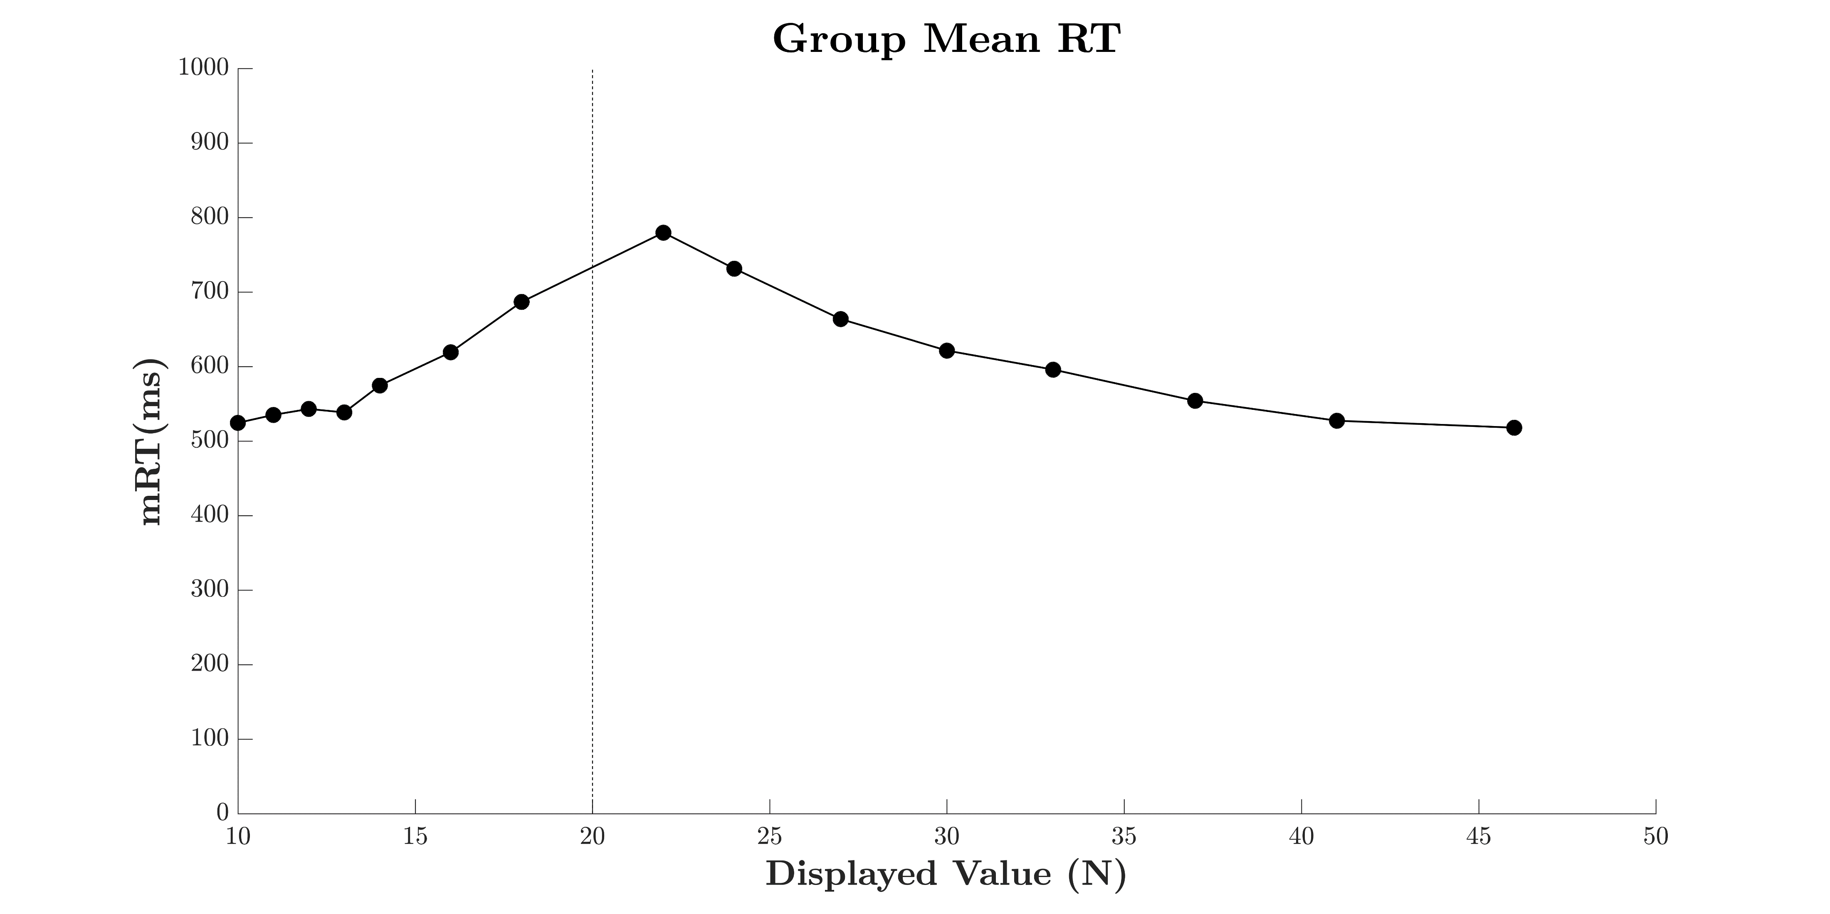
Study 1
Study 1

Slide 26
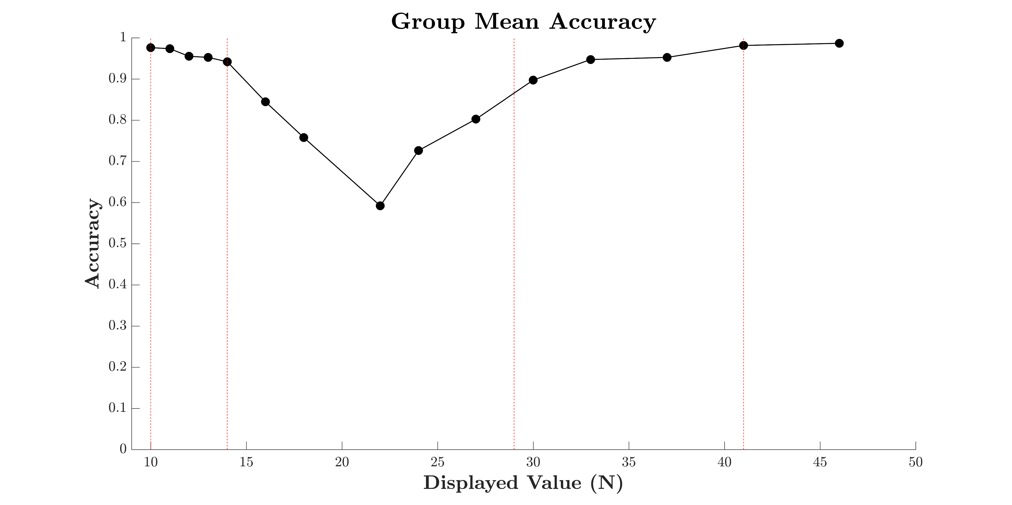
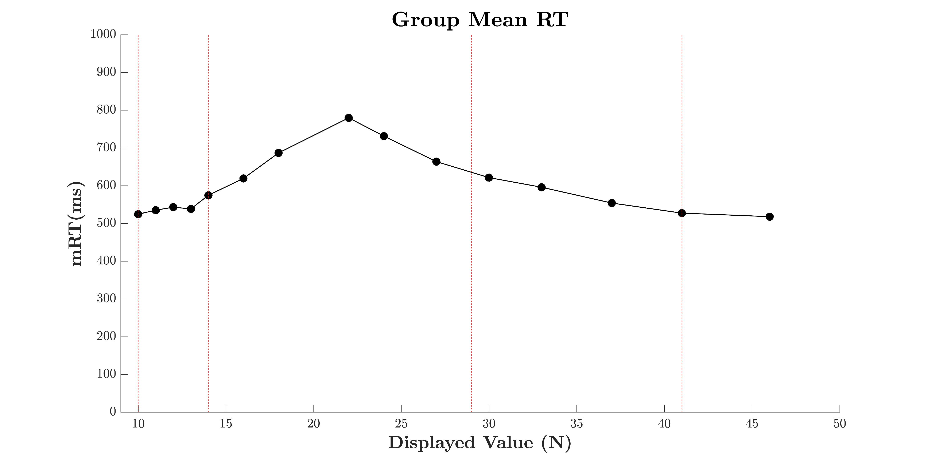
Study 1
Study 1
Target Values
High Salience = 10
Low Salience = 14
Distractor Values
High Salience = 29
Low Salience = 41

Slide 27
Study 2
Aim
Apply SFT to an Estimation task using Study 1 Salience
Design
1 Practice block with feedback
15 Blocks of 96 Trials
Manipulation of Load
Redundant Target Task w/ Distractor Item Sets
Manipulation of Salience
Numerical Distance Effect
Methodology

Slide 28
Methods - Design
Target Red
Present
Absent
Salience Red
Salience Red
High
Low
High
Low
High
10
10
14
10
High
41
10
29
10
Present
Methodology
Salience Blue
Salience Blue
10
14
14
14
41
14
29
14
Low
Low
Target Blue
Salience Red
Salience Red
High
Low
High
Low
High
10
41
14
41
41
41
29
41
High
Absent
Salience Blue
Salience Blue
10
29
14
29
41
29
29
29
Low
Low

Slide 29
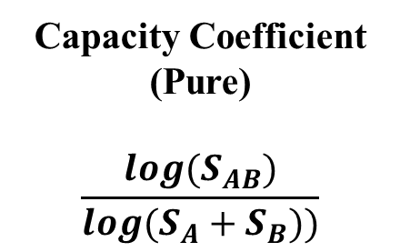
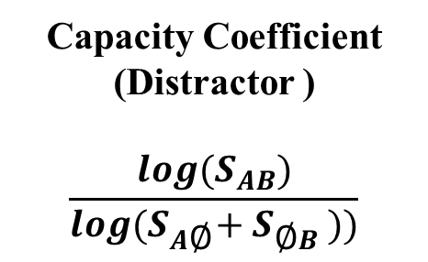
Methods - Design
Target Red
Present
Absent
Single Colour Set
Capacity Coefficient (Distractor )
$$\frac{log(S_{AB})}{log(S_{A\text{∅}}+S_{\text{∅}B}))}$$
Salience Red
Salience Red
Red
High
Low
High
Low
Present
Absent
10
10
14
10
41
10
29
10
High
10
41
High
High
Salience
Present
Methodology
Salience Blue
Salience Blue
10
14
14
14
41
14
29
14
14
29
Low
Low
Low
Target Blue
Capacity Coefficient (Pure)
$$\frac{log(S_{AB})}{log(S_{A}+S_{B}))}$$
Salience Red
Salience Red
Blue
High
Low
High
Low
Present
Absent
10
41
14
41
41
41
29
41
High
10
41
High
High
Absent
Salience
Salience Blue
Salience Blue
10
29
14
29
41
29
29
29
14
29
Low
Low
Low

Slide 30
Methods
ITI
500ms
Fixation Cross
500ms
RTI
4000ms
Methodology
Stimulus
1000ms
Mask
500ms
Post Mask Blank
2500ms

Slide 31
Methods
Equal Size
Equal Area
Equal Density
Mixed Sets
Methodology
Stimulus
Sets
Split Sets

Slide 32

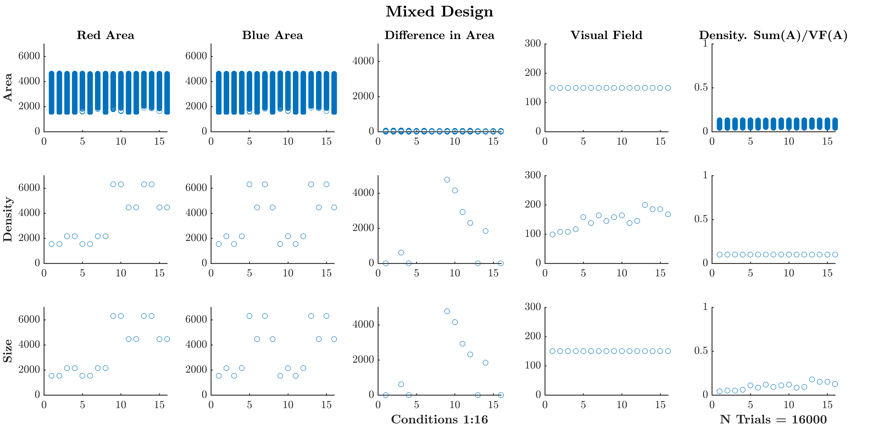
Methods
Methodology

Slide 33


Methods
Methodology

Slide 34
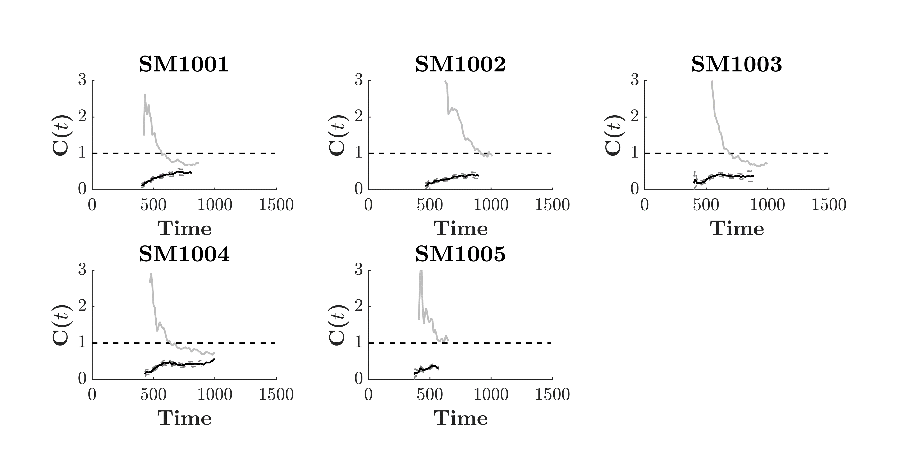
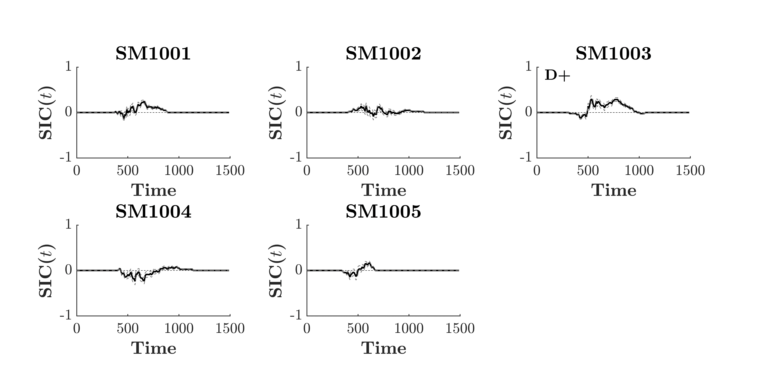
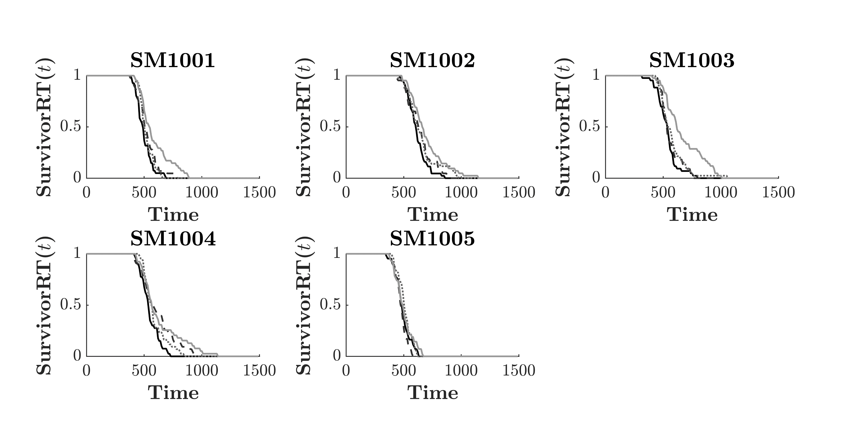
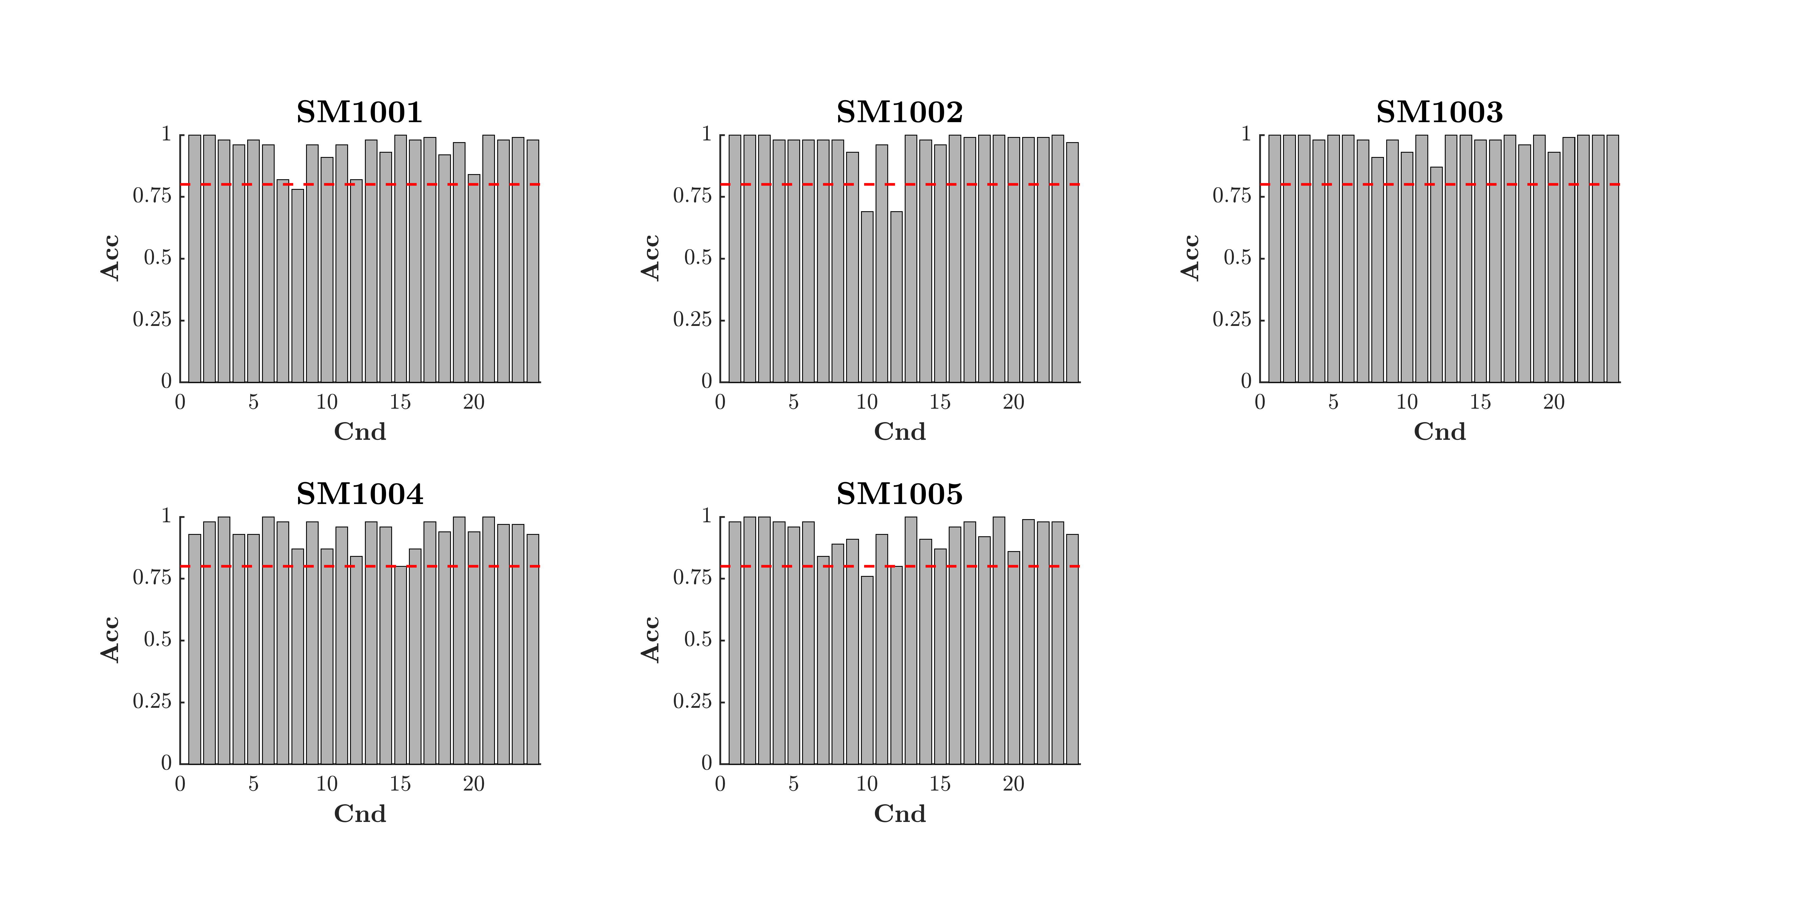
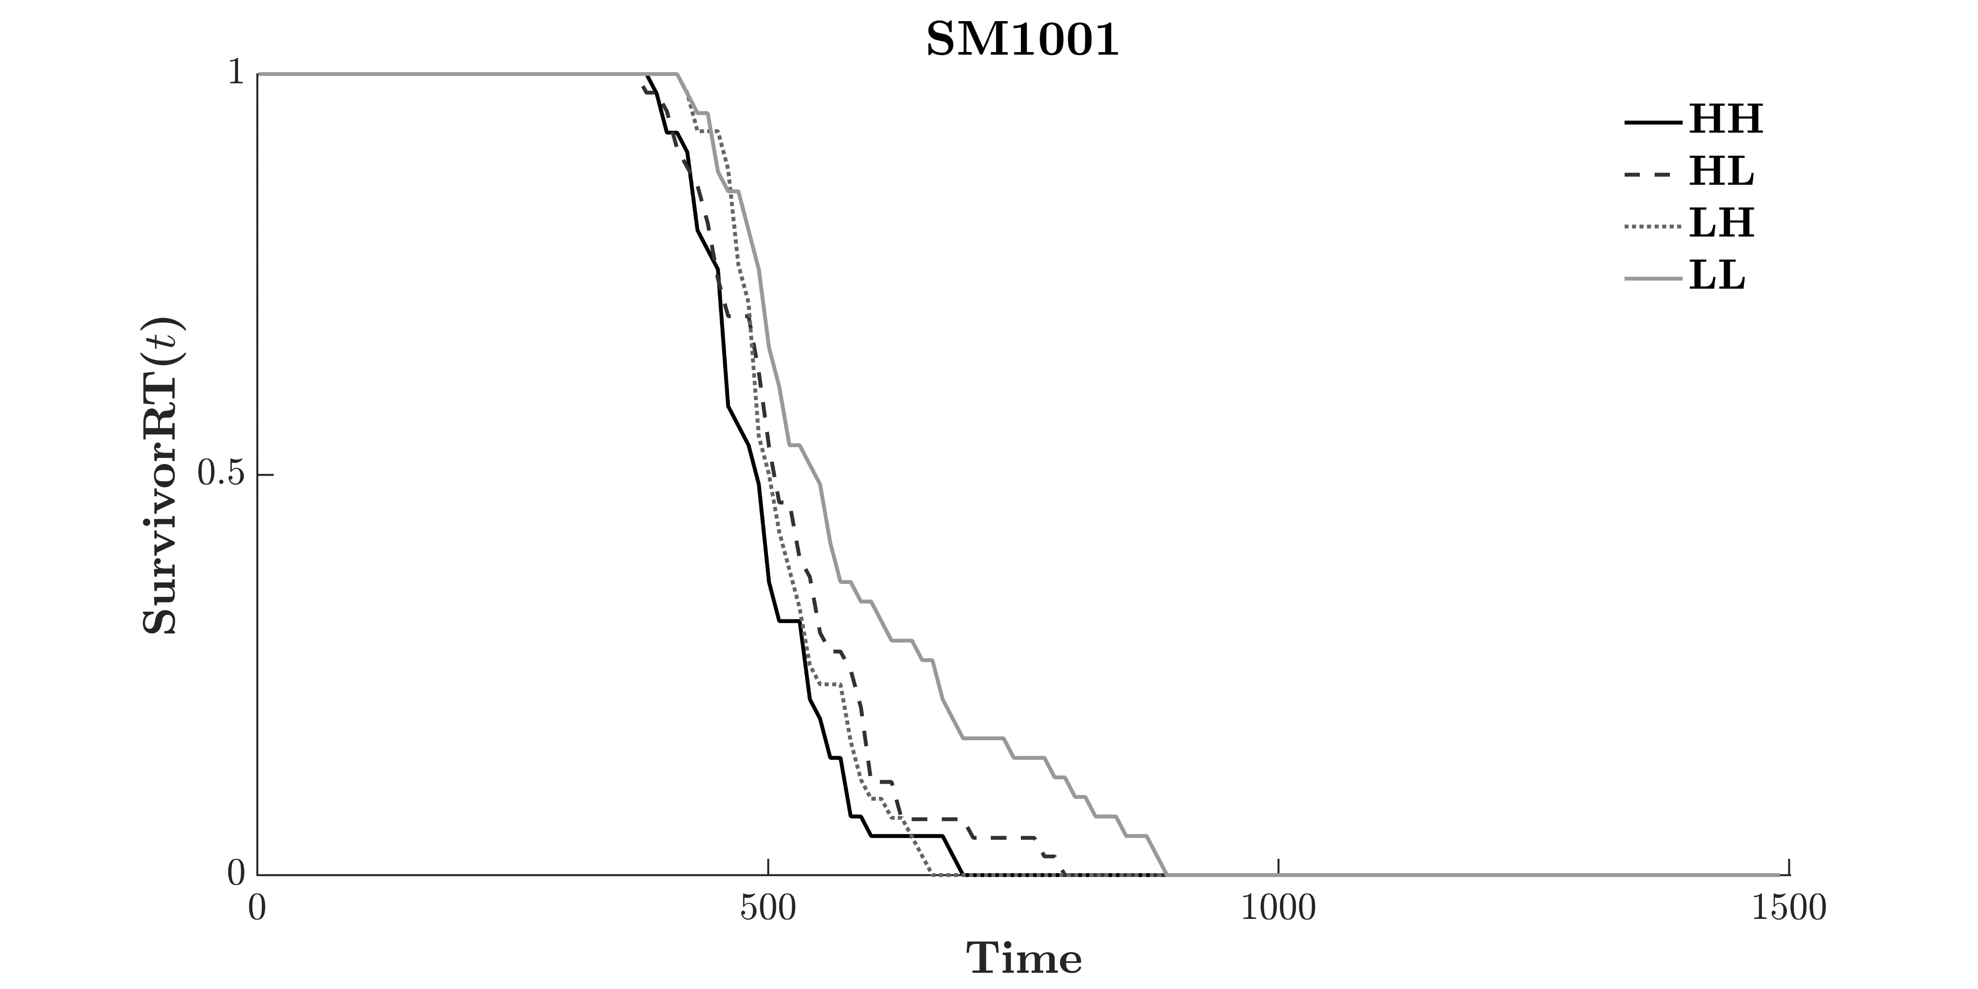
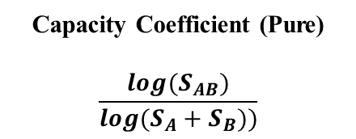
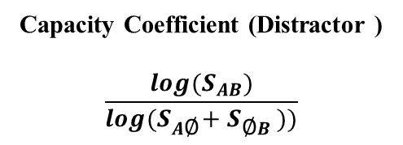
Study 2 – Even Size (Mixed) AB
Study 2
Capacity Coefficient (Distractor )
$$\frac{log(S_{AB})}{log(S_{A\text{∅}}+S_{\text{∅}B}))}$$
Capacity Coefficient (Pure)
$$\frac{log(S_{AB})}{log(S_{A}+S_{B}))}$$

Slide 35
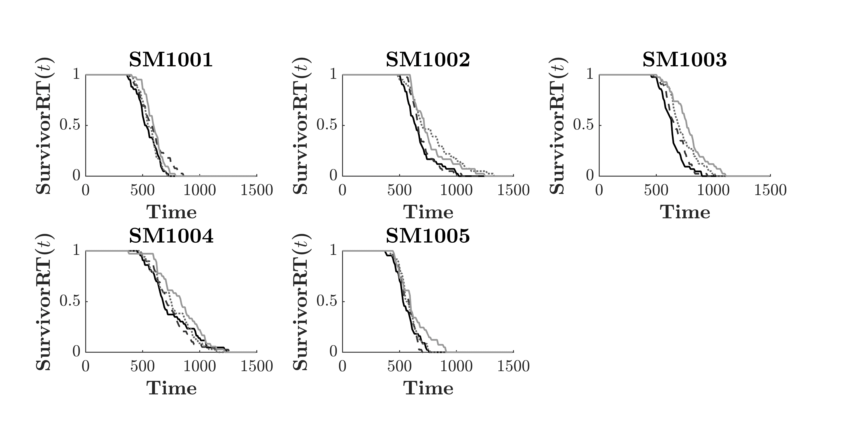
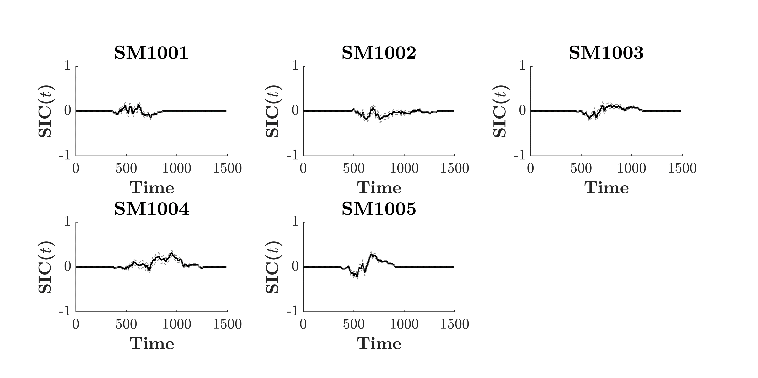
Study 2 – Even Size (Mixed) Nil
Study 2

Slide 36
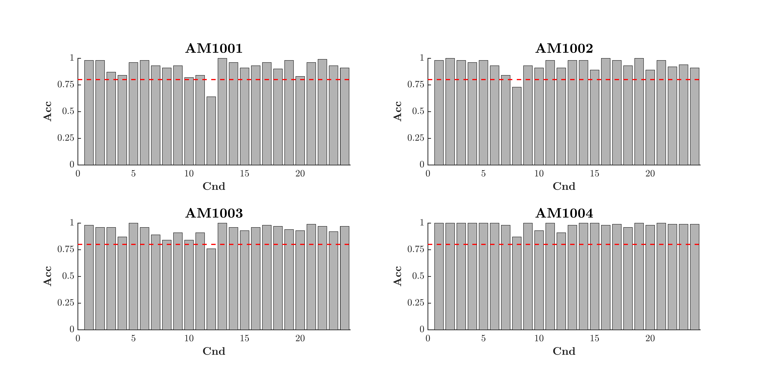
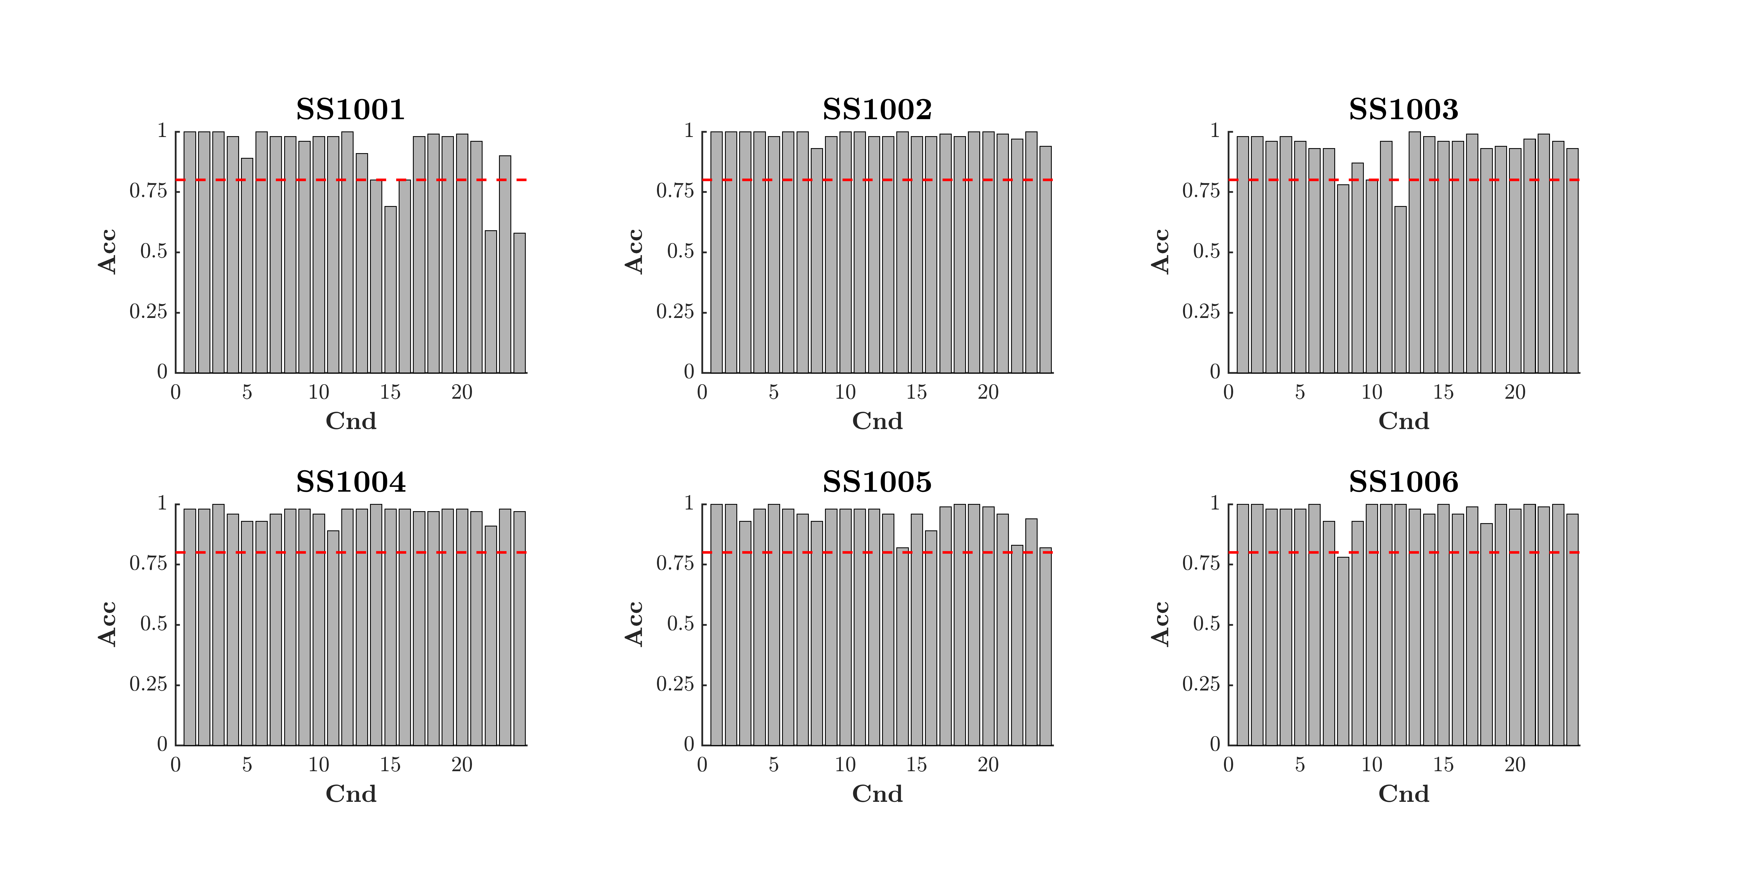
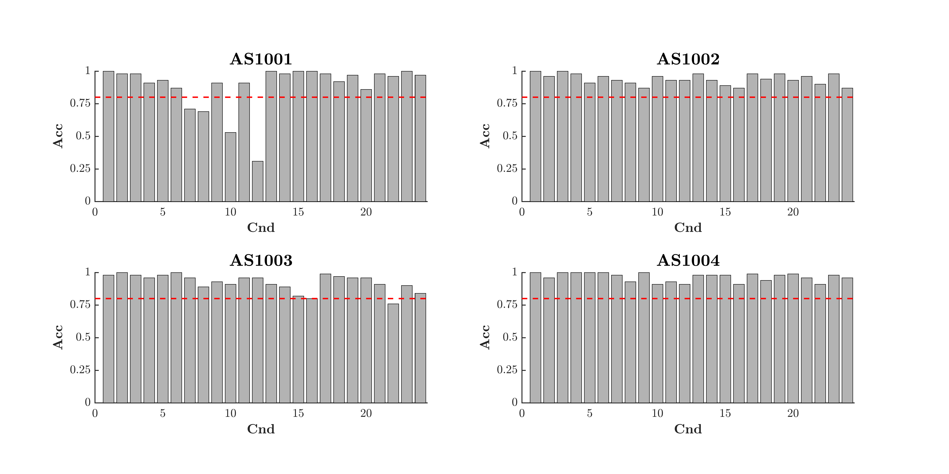
Double Target SIC_{(OR)}
Even Size
Even Area
Mixed Design
Study 2
Split Design

Slide 37

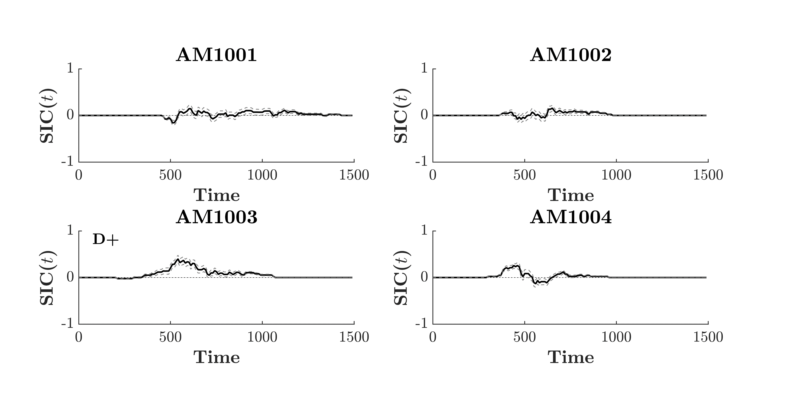
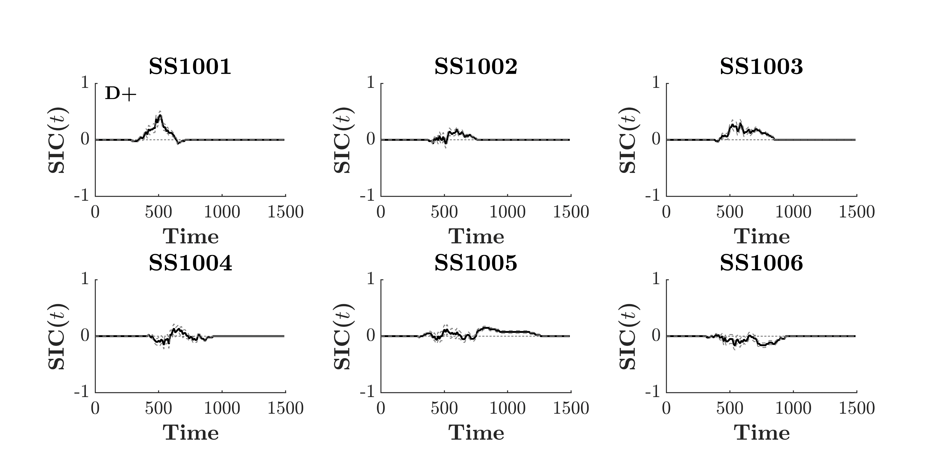
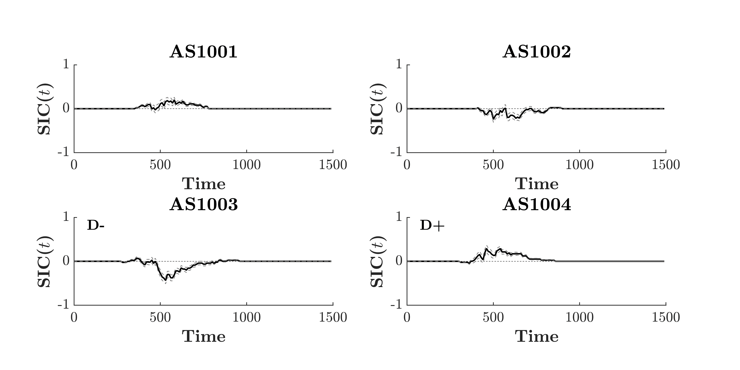
Double Target SIC_{(OR)}
Even Size
Even Area
Mixed Design
Study 2
Split Design

Slide 38
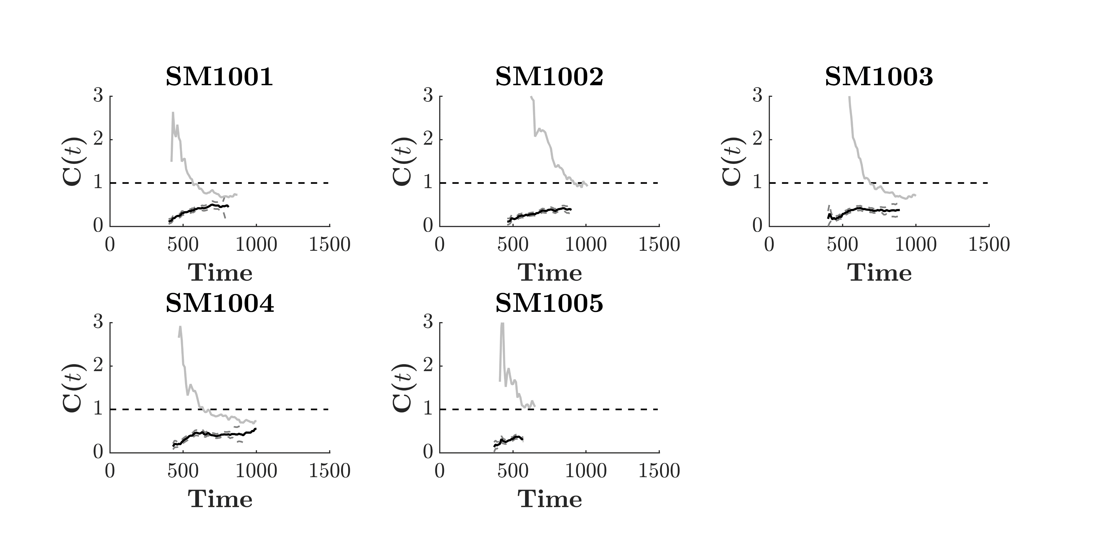
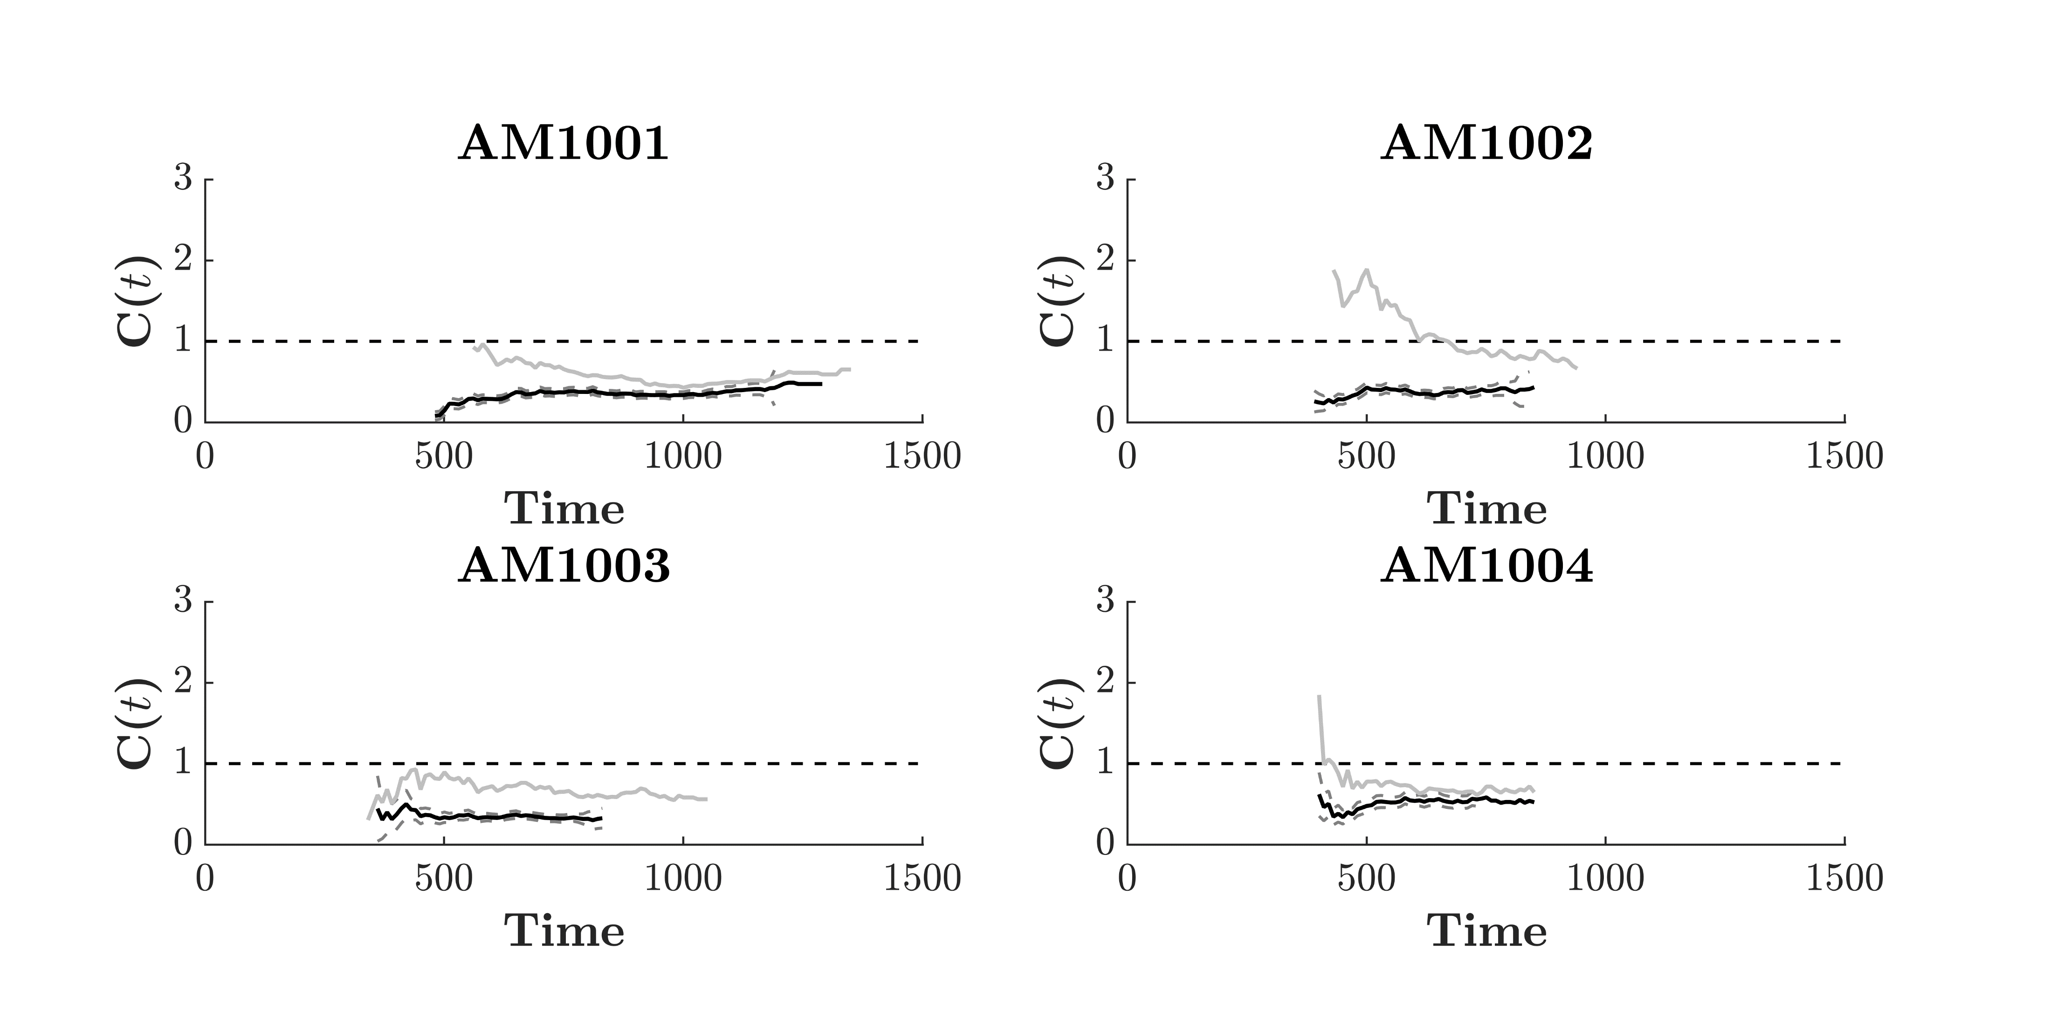
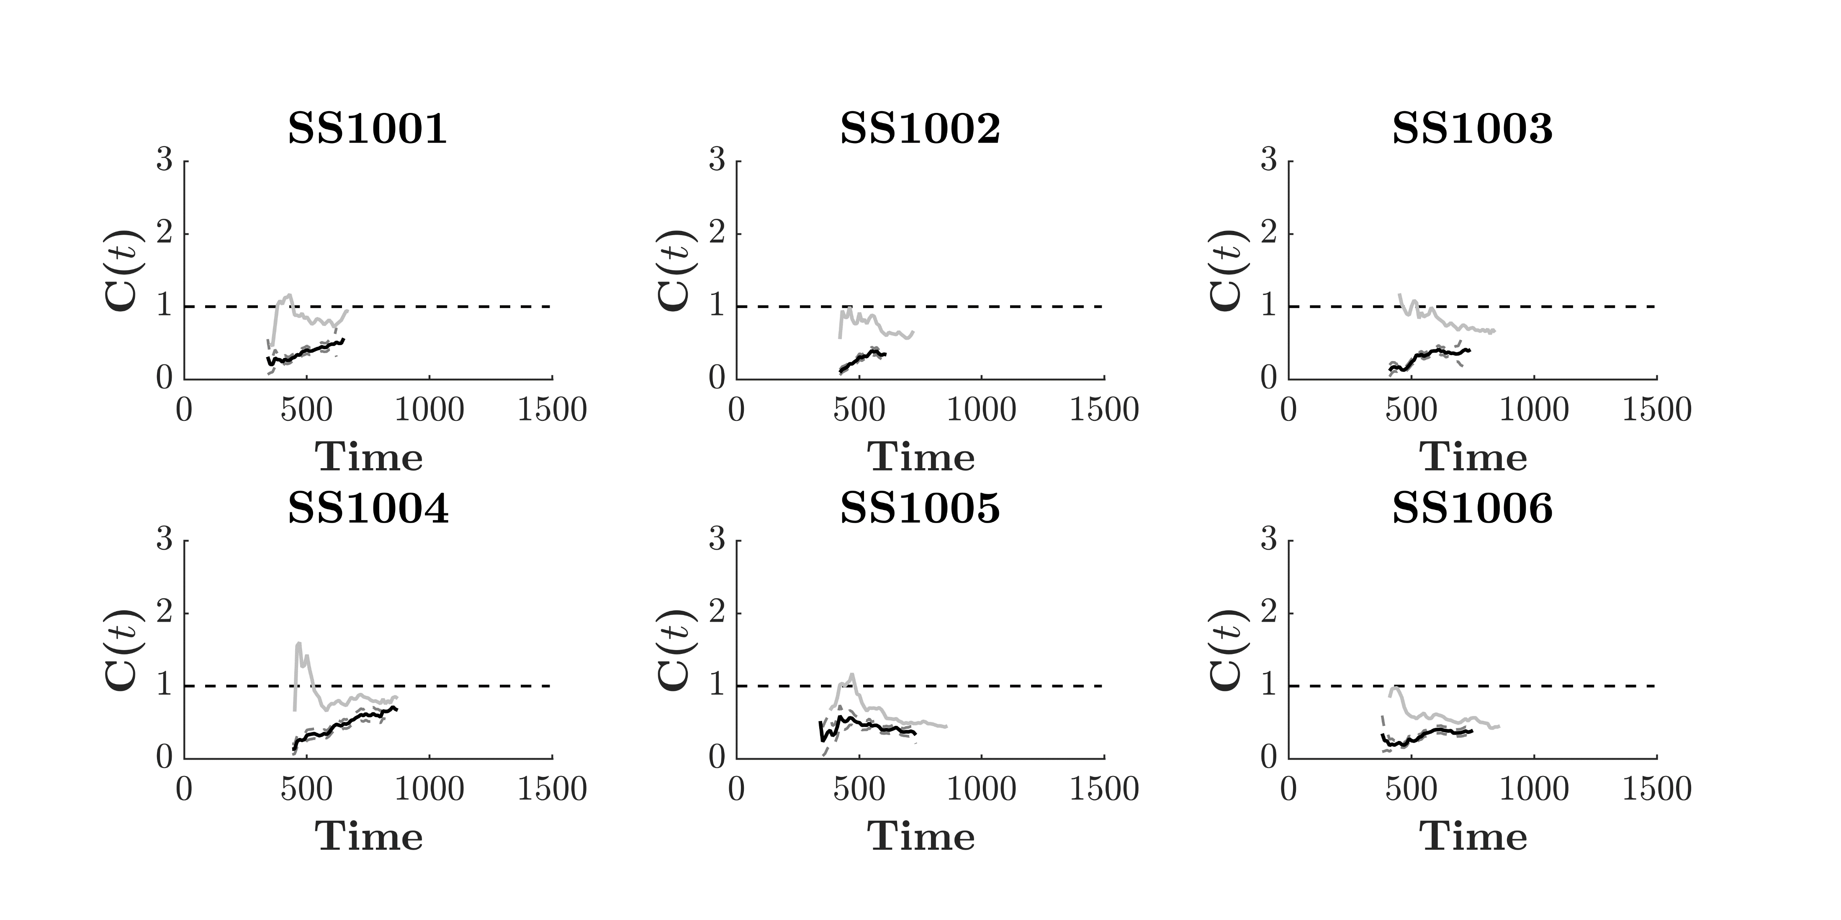
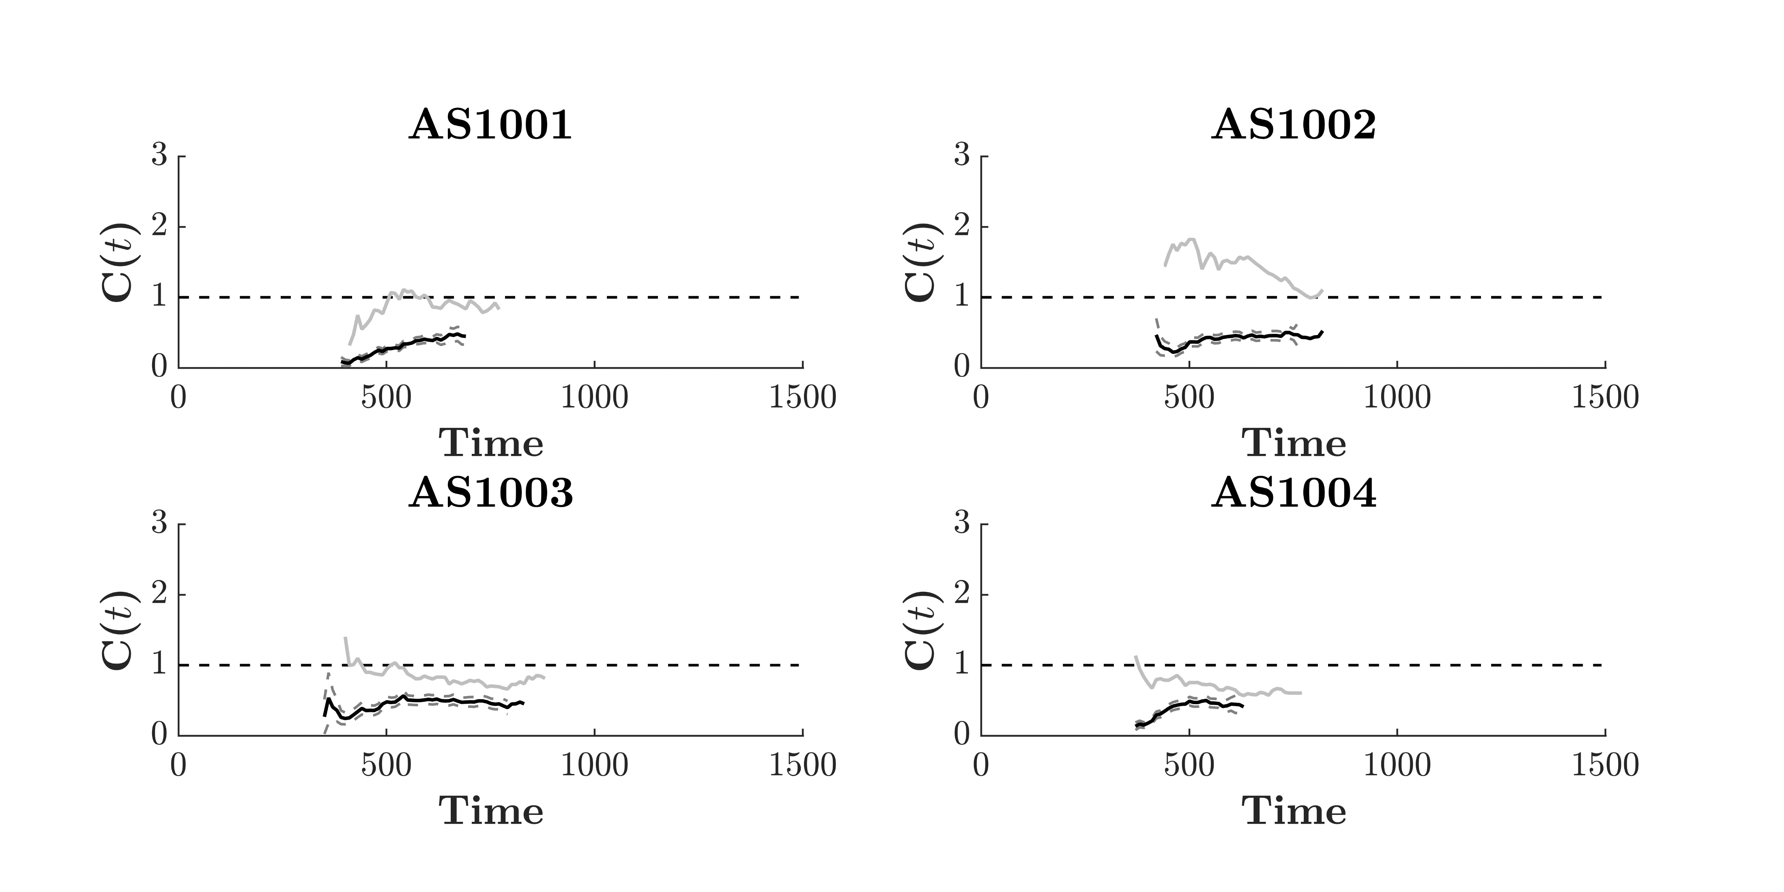
Capacity Coefficient_{(OR)}
Even Size
Even Area
Mixed Design
Study 2
Split Design

Slide 39

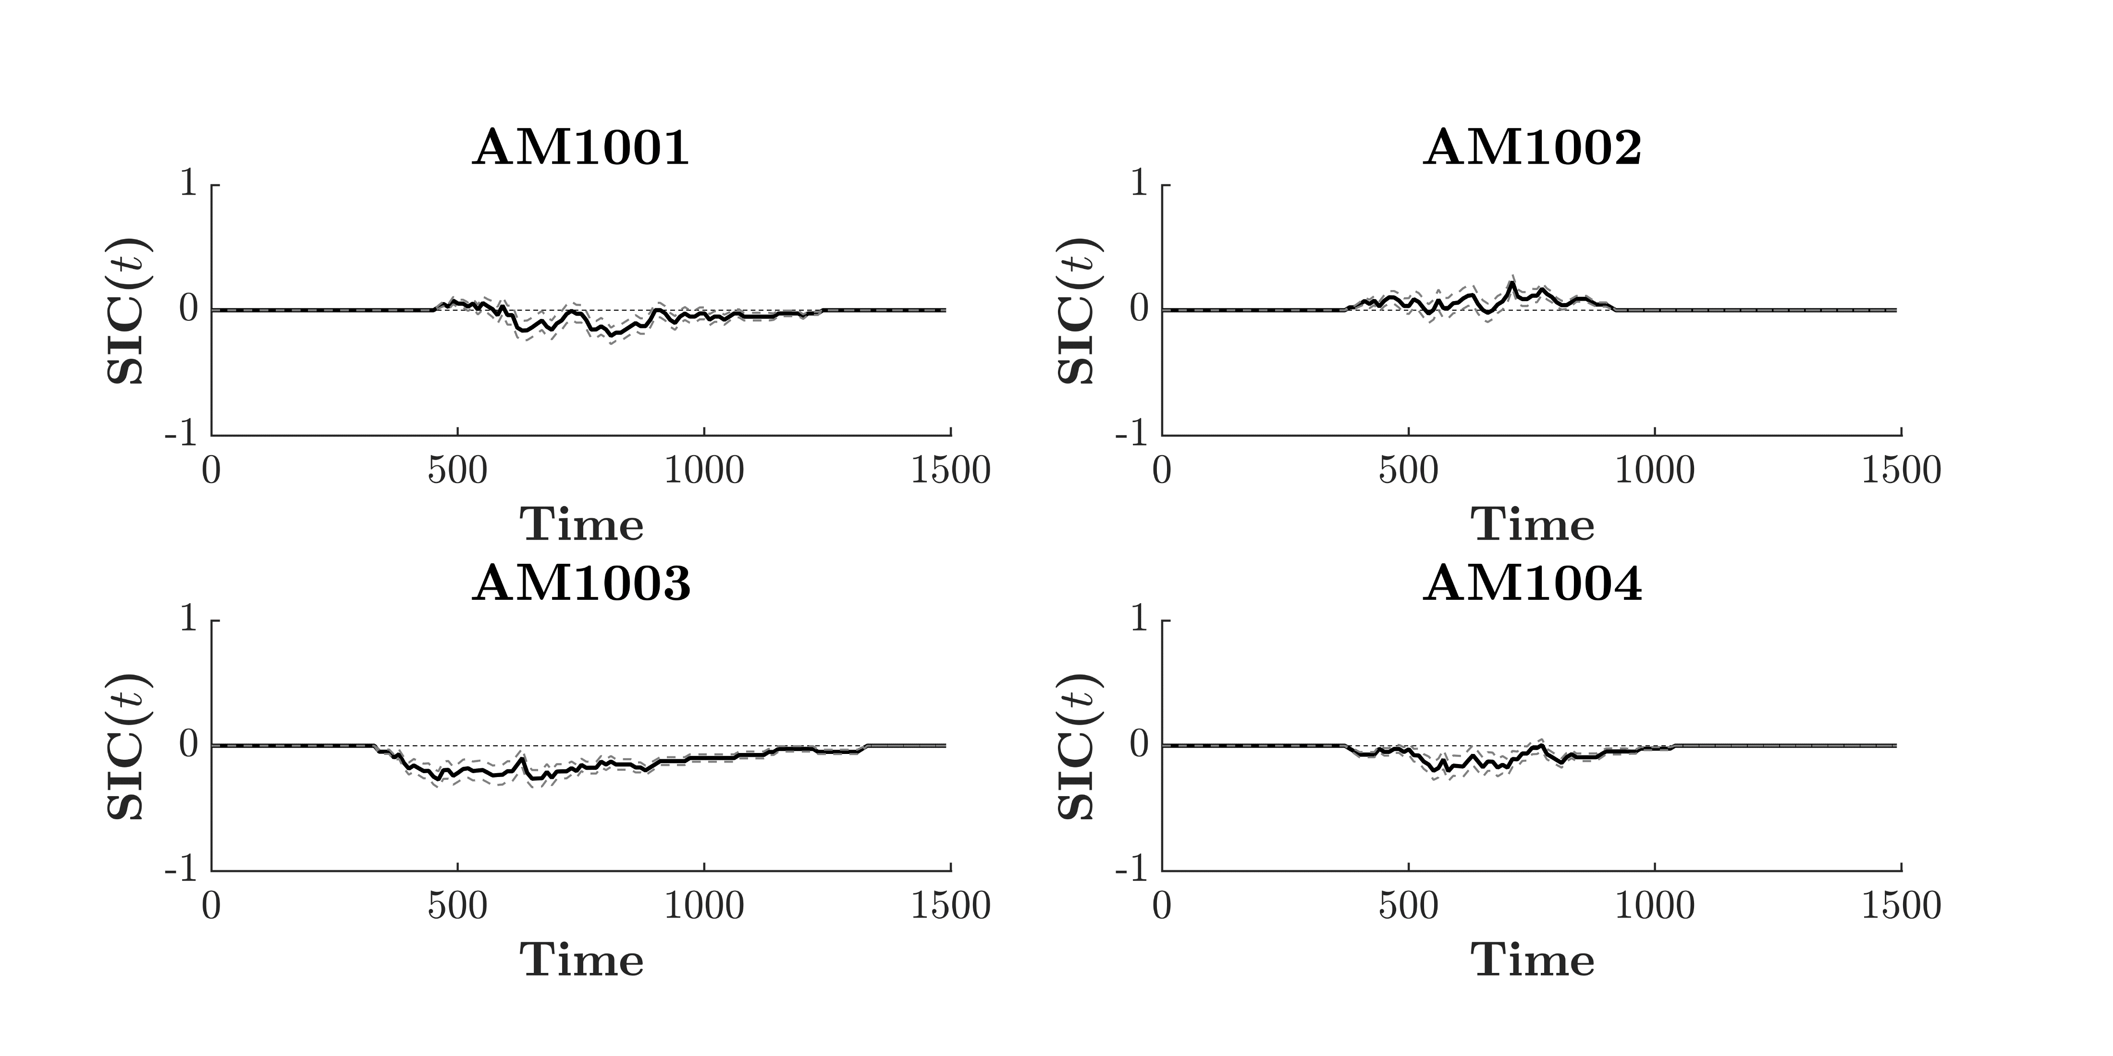
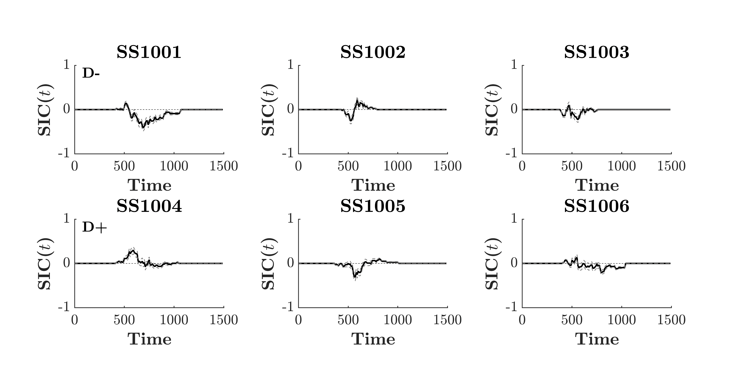
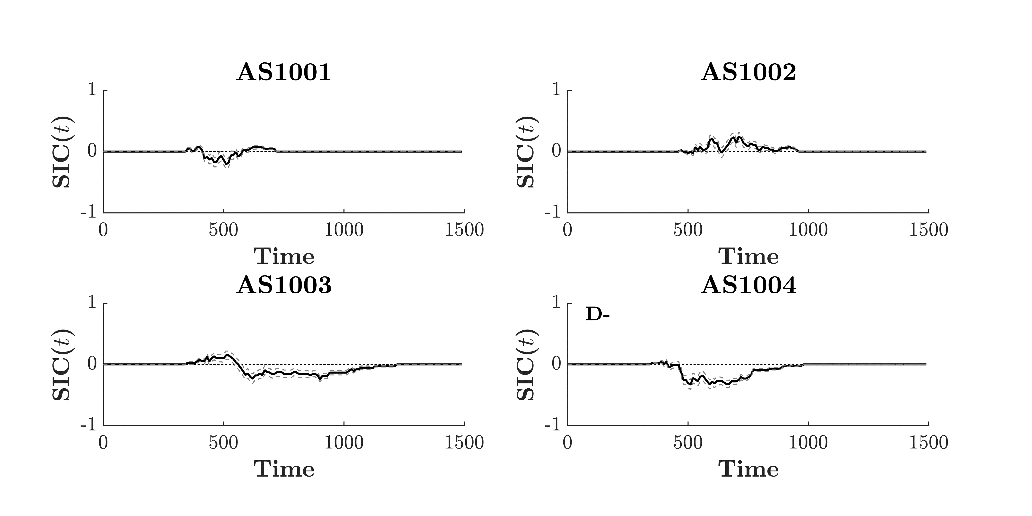
Double Distractor SIC_{(AND)}
Even Size
Even Area
Mixed Design
Study 2
Split Design

Slide 40
Issues with Current Analysis
Trial Numbers may be insufficient for clear SIC
Stochastic Dominance is violated by many participants
We need a better way of address this…
Study 2

Slide 41
Advancing SFT
Assume you have some pilot SFT data. You want to know:
Do I have enough trials for a diagnostic SIC
If not, how many trials do I need?
Is my salience effect enough for a diagnostic SIC?
If not, what salience levels do I need?
This is where LBA Modelling can help
Advancing SFT

Slide 42
Advancing SFT - LBA
Evidence Accumulation for Channel A
Evidence Accumulation for Channel B
Response Threshold
Advancing SFT
b
Normally Distributed Drift Rate (v)
Uniform Start Point
U(0, A)
Decision Time
( b – K ) / v
K
Time (t)
Time (t)

Slide 43
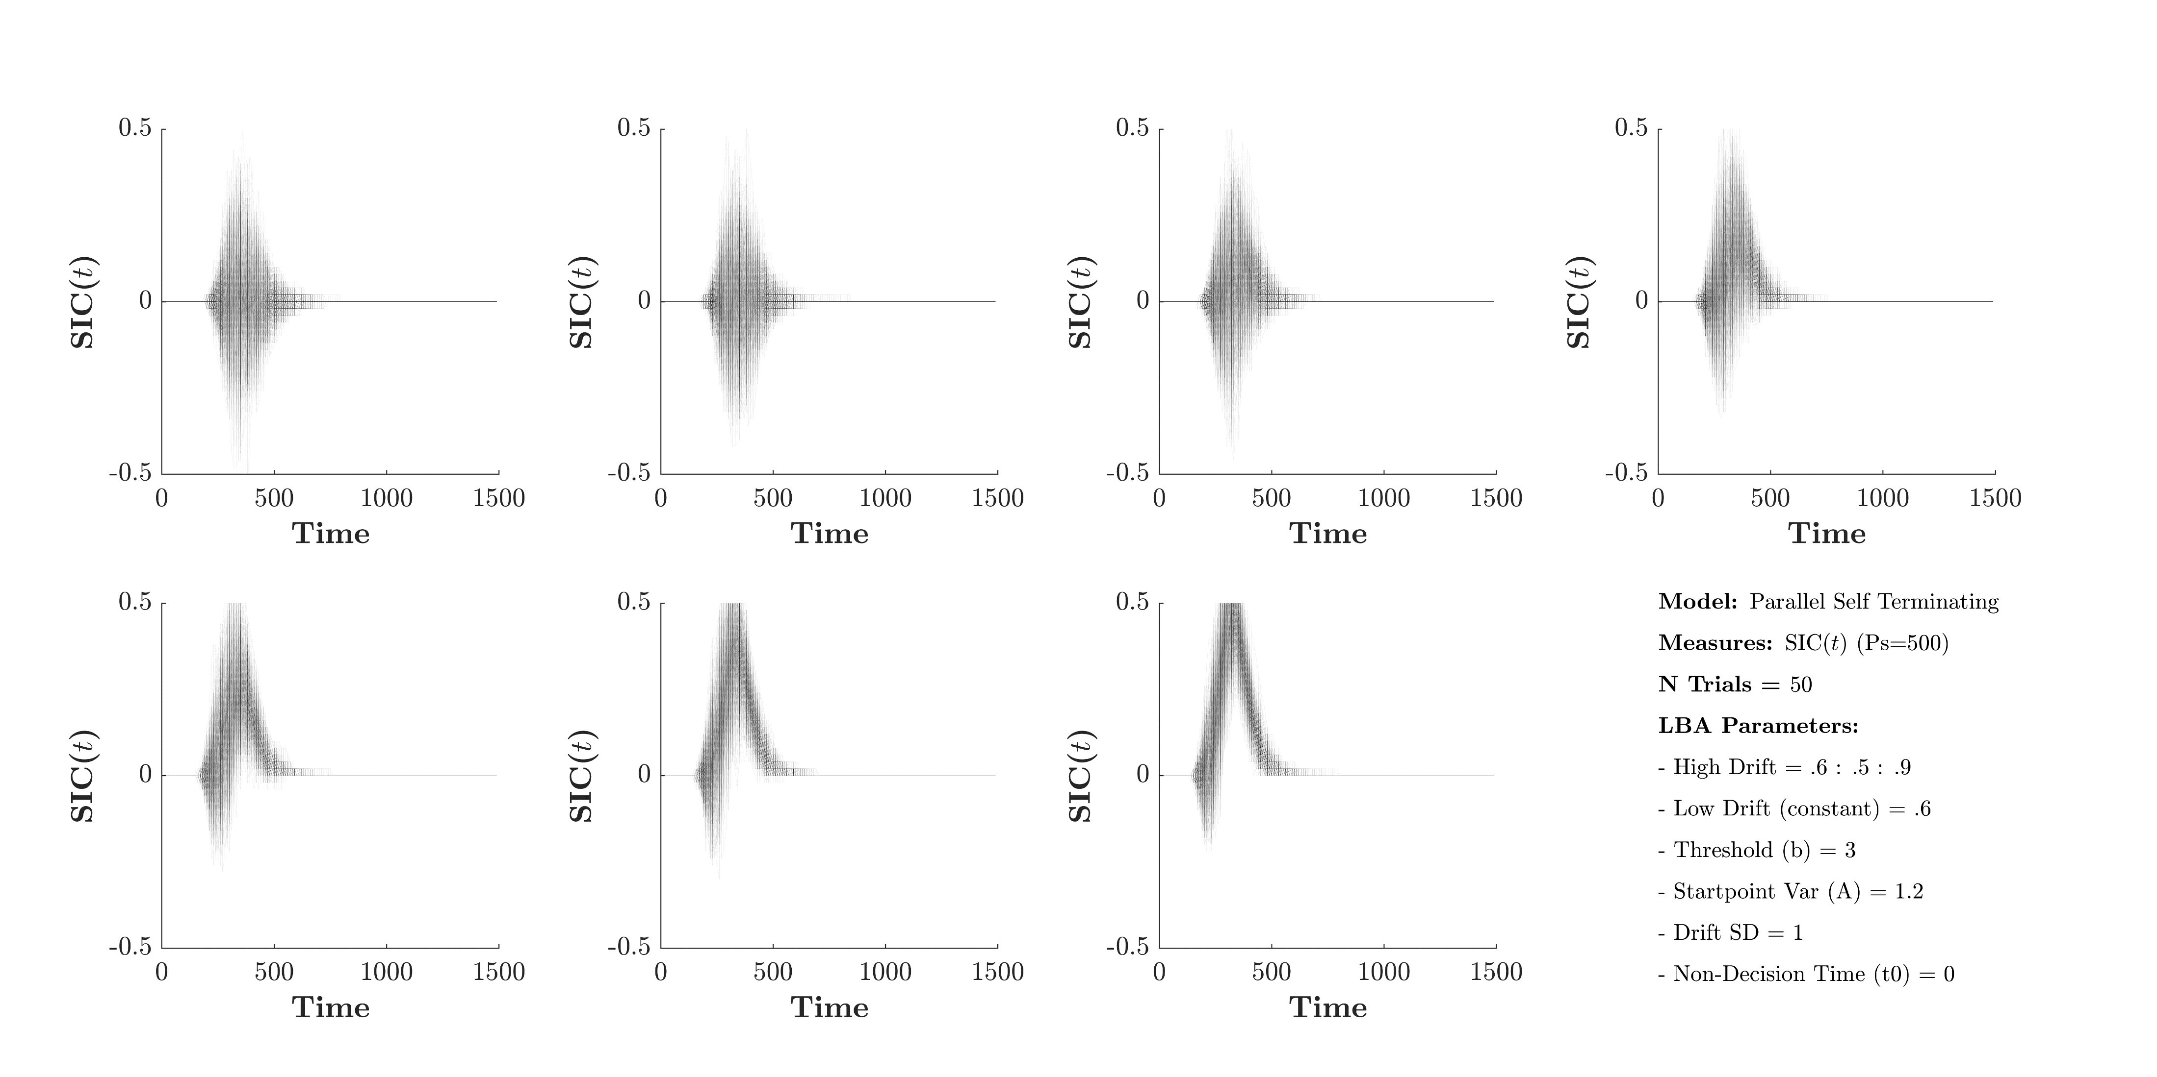
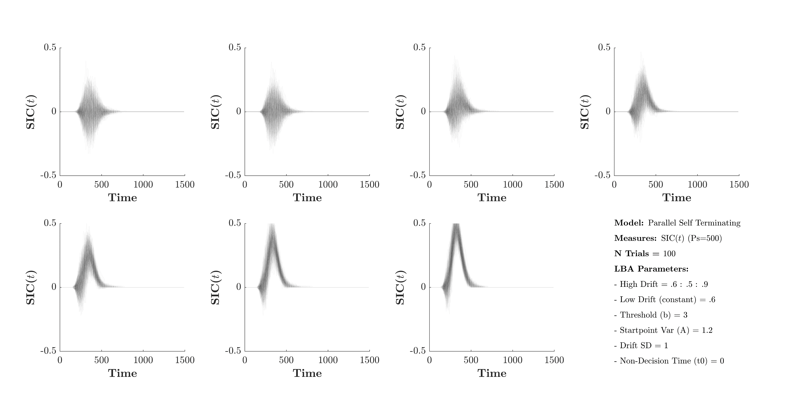
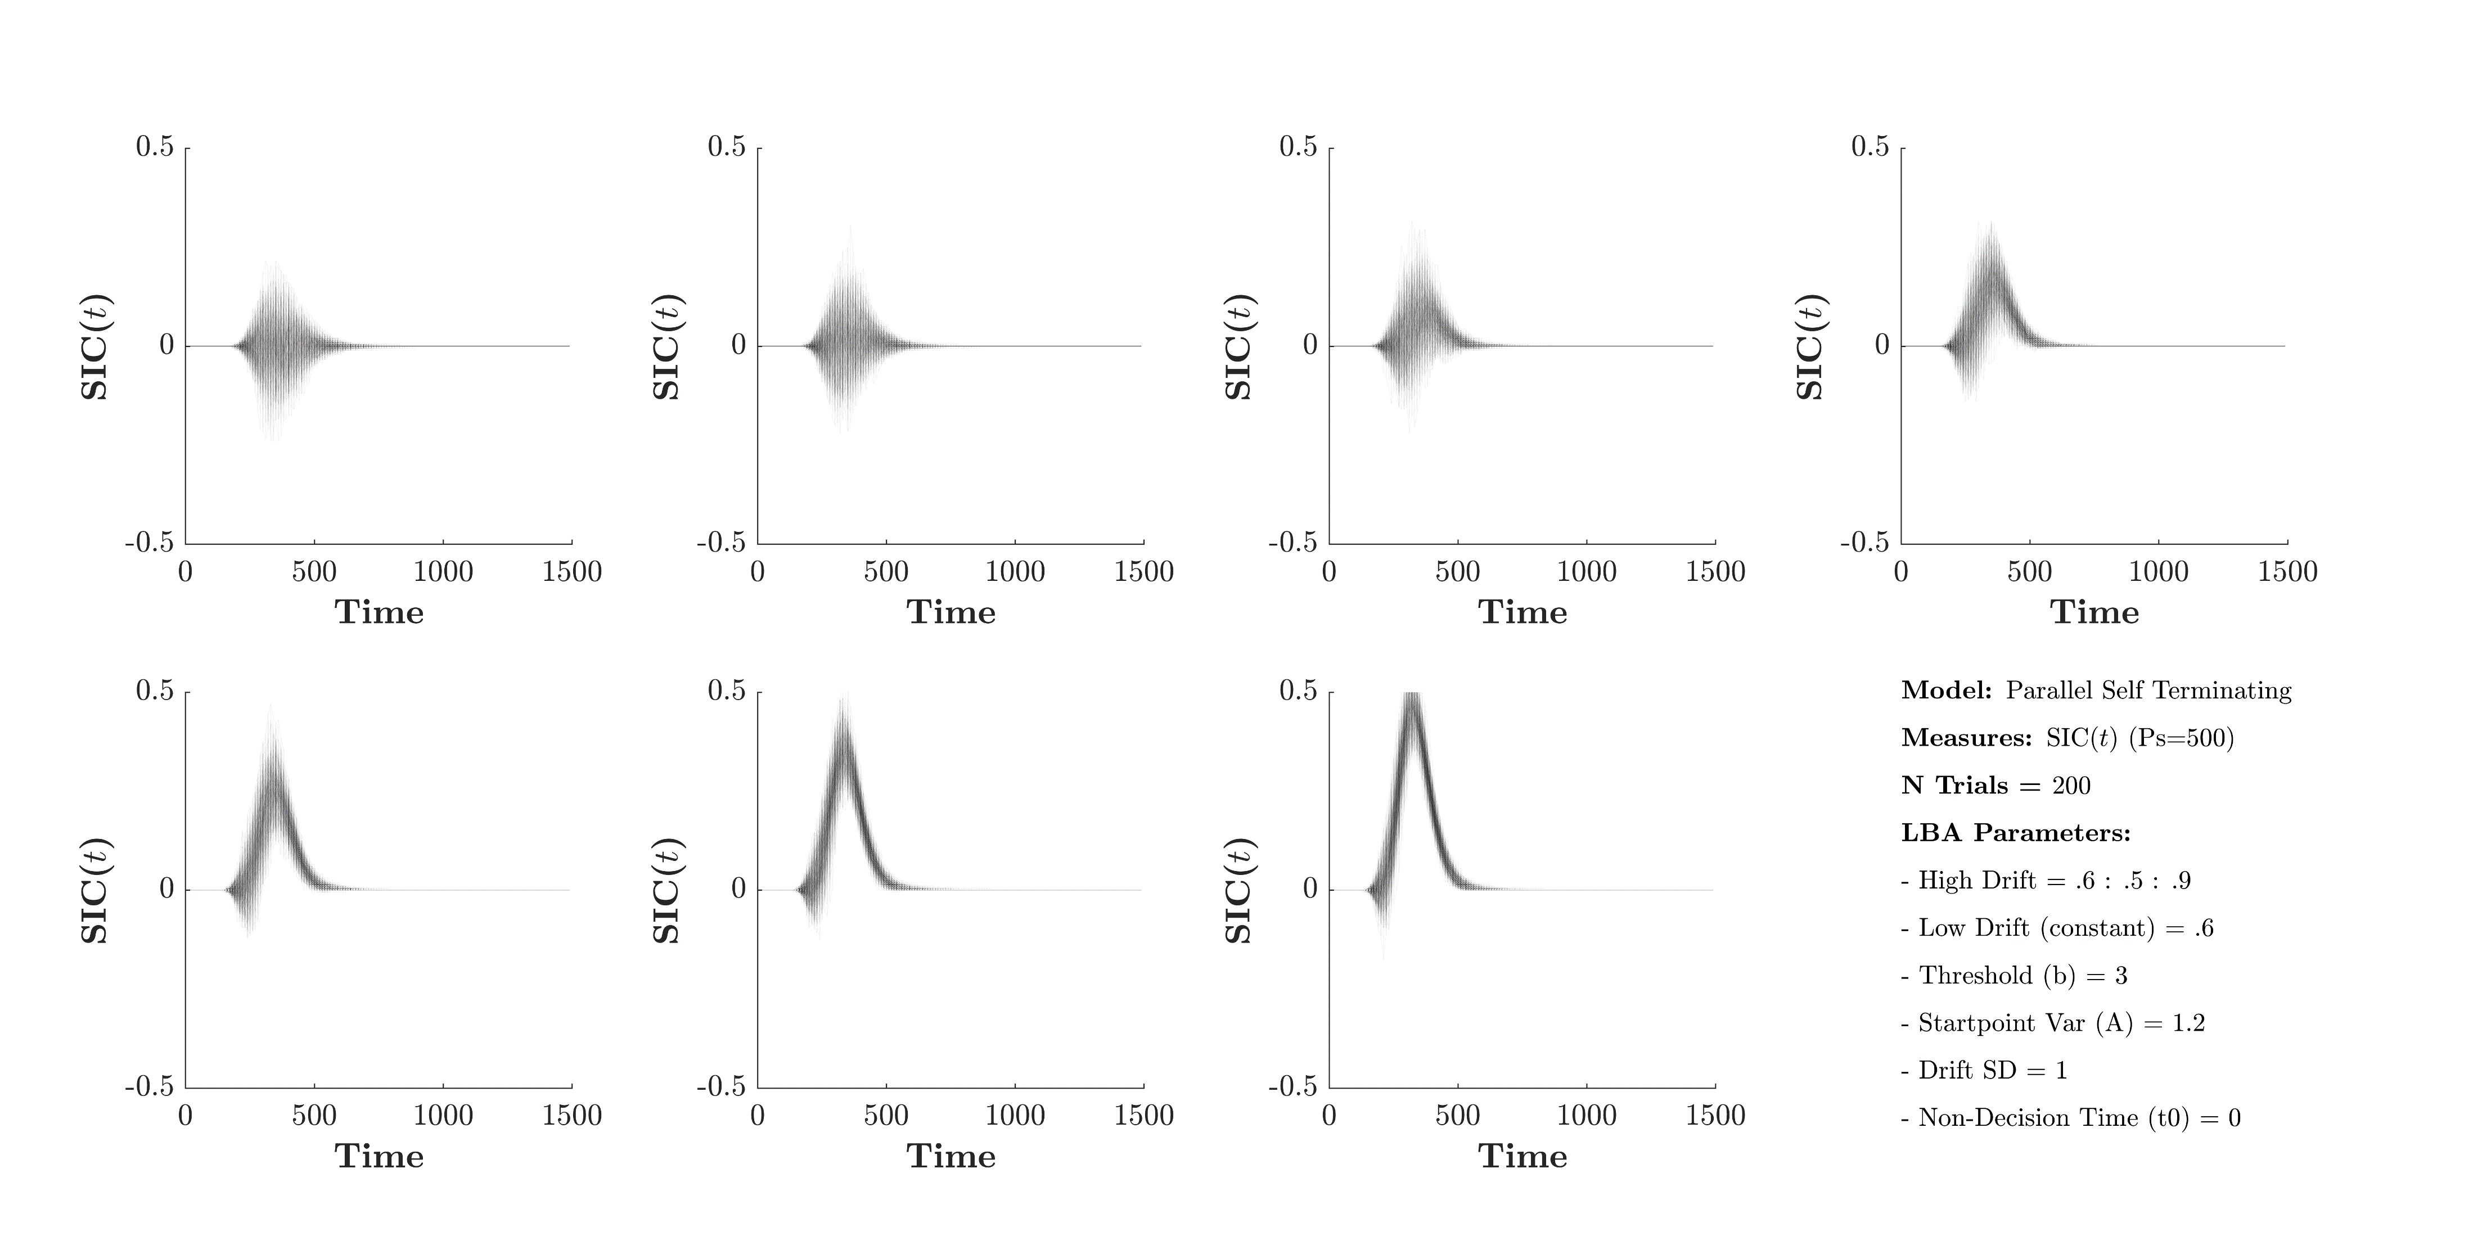








Advancing SFT – Parallel Min Time
Advancing SFT

Slide 44











Advancing SFT – Parallel Max Time
Advancing SFT

Slide 45











Advancing SFT – Serial Min Time
Advancing SFT

Slide 46











Advancing SFT – Serial Max Time
Advancing SFT

Slide 47
Conclusion
SFT can be applied to the study of Estimation Systems
Estimation Systems may occur in parallel or serial
Estimations Systems always resolve in limited to severely limited capacity
The assessment of drift rate to a single channel may become a useful tool in a-priori estimates of trial number and in creating selective dominance
Conclusion

Slide 48





Thank you to my collaborators
Ami Eidels
David Landy
Joseph Houpt
Conclusion

Slide 49
Methods - Design
Criterion 20 Items. Question. Is either set less than 20?
Double Stimulus | HH | HL | LH | LL
AB | 10 v 10 | 10 v 14 | 14 v 10 | 14 v 14
A∅ || ∅B | 10 v 41 | 10 v 29 | 14 v 41 | 14 v 29
∅∅ (Nil) | 41 v 41 | 41 v 29 | 29 v 41 | 29 v 29
Single Stimulus | High | Low
A || B Target Pure | 10 | 14
A || B Distractor Pure | 41 | 29
Methodology

Slide 50






Study 2 – Even Size (Mixed) AB
Study 4
Capacity Coefficient (Distractor )
$$\frac{log(S_{AB})}{log(S_{A\text{∅}}+S_{\text{∅}B}))}$$
Capacity Coefficient (Pure)
$$\frac{log(S_{AB})}{log(S_{A}+S_{B}))}$$

